Slide 1

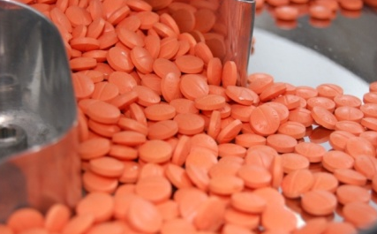
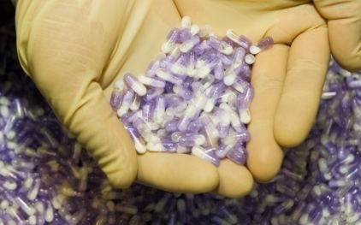

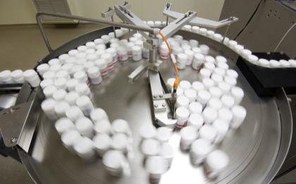
1ST INTERNATIONAL HIGH LEVEL MULTI-STAKEHOLDERS WORKSHOP ON PROMOTING PHARMACEUTICAL SECTOR INVESTMENT IN THE EAST AFRICAN COMMUNITY (EAC) REGION
REGIONAL GMP ROADMAPS FRAMEWORK
Laico Hotel, Nairobi, November 2 – 5, 2016
Wilberforce O Wanyanga
National Pharmaceutical Expert, UNIDO
W.Wanyanga@unido.org
j.reinhardt@unido.org

Slide 2
Background
Goal of UNIDO pharmaceutical project: increase the capacity of Local Pharmaceutical sector in developing countries to supply safe, efficacious and affordable medicines
Many people die because they do not have access to safe and efficacious medicines.
Many diseases are regularly found (or endemic) in Africa and often prove fatal when they're not treated quickly and efficiently.
There was need to develop a global partnership for development of the pharmaceutical sector in L(D)Cs
UNIDO’s approach includes working with key local stakeholders including: Industry associations, Ministries responsible for Industrialization and for Health, and the National Medicines Regulatory Agencies

Slide 3
UNIDO activities in Africa
Continental level
AUC/NEPAD
Reginal associations: FAPMA/FEAPM/SAGMA/
ECOWA/WAPMA
Joint approach
GIZ to support Market data
WHO on GMP Roadmaps & risk approach on EML (integration of approaches ongoing)
Selected current country activities
Kenya
  Implementation of KPSDS and Kenya GMP Roadmap
  Lean Six Sigma (operational efficiency) mentorship program
  Regulator and industry capacity building
  Establishment of governance structure
Ghana
  GMP gap assessments – ongoing
  Other Regulator support activities

Slide 4
Context/Key issues
Many companies operate below international GMP standards
Need to support Regulatory authorities often outstretched & inadequate capacity
  Political context alone makes closing facilities en masse non-viable
Many manufacturing facilities across Africa have potential for upgrading
  However, upgrading requires conducive environment to be established through policy coherence, access to capital, enhanced regulatory oversight, but cannot happen overnight, etc.
Roadmap concept intended to assist regulators to define practical timelines and benchmarks for industry to meet in upgrading & GMP compliance
  Intended to work in conjunction with risk categorization of products to mitigate public health risk during transition
Industry also needs support > Technical Assistance in skills transfer, know-how and capacity building

Slide 5
Good Manufacturing Practice (GMP)
Is a compilation of quality measures for production and quality control of medicinal products
Ensures that quality of medicinal products is assured consistently and that the products are safe and efficacious
WHO GMP selected as this is most appropriate standard:
internationally recognised and widely accepted
Quite difficult to review and maintain other standards
Perception of inferior unless stringent means of authentication
>> Always check WHO website for latest updates

Slide 6
Development process for GMP Roadmap
Development of GMP Roadmap structure and tools
Baseline assessment of manufacturers
Tailored approach, combining overall roadmap concept with individual country requirements
Roadmap development
Representative sample of companies assessed
Identification of common main technical challenges
Risk-based, phased multi-year program
Collaborative process involving key national stakeholders working in partnership with UNIDO
  Ministry of Health
  Ministry of Industry
  National regulatory body (ies)
  Industry and/or Associations

Slide 7
Three -step process
STEP 1: Baseline assessment of existing manufacturing practices
Basis for specific RM design; thorough preparation and conduct essential
  Selection of representative sample of companies (different GMP compliance levels)
  Field studies at selected companies
Tool 1: Definition of key elements and focus areas
Tool 2: Preparation of an assessment schedule
Tool 3: Definition of rating of observations (critical-major-other)
STEP 2: Evaluation of assessment results & identification of main technical challenges
Tool 1: Identification of key quality elements affected by highest and lowest compliance with WHO GMP
Tool 2: Risk categorization of companies based on their compliance with WHO GMP
STEP 3: Design of a GMP Roadmap based on evaluation results
Risk based, phased approach to establish a structured framework that the NRA can implement over time to require and guide manufacturers to improve to WHO GMP by a defined deadline

Slide 8
Tools developed for company & industry analysis
Highlights most common technical challenges faced within a country
Used in development of Roadmap
Trending – follow industry progress over time
Identify key elements with highest and lowest compliance to WHO GMP
Gives objective measurement of company compliance to WHO GMP
Used by company to develop its remediation plan (Corrective and Preventive Action or CAPA plan)
Categorize companies based on compliance to GMP

Slide 9
GMP can be broken down into two key dimensions
GMP
SITE
Physical entity
    Premises
    Utilities
    Equipment
QUALITY MANAGEMENT SYSTEM (QMS)
  Systems
  Procedures

Slide 10
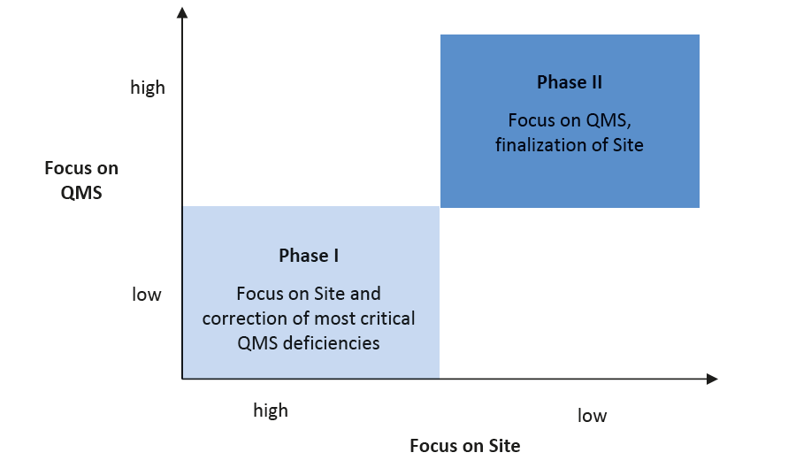
Design of Roadmap
A two phase roadmap was developed in Kenya
  To reflect priority of improvement needs
  To ensure gradual /stepwise improvement

Slide 11
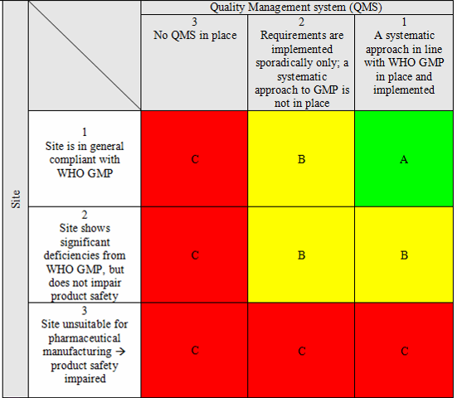
Risk categorization of Pharmaceutical Manufacturers based on the two key dimensions
  Existing approach towards pharmaceutical manufacturing in general in line with WHO GMP requirements
  → Low risk company
  Existing approach towards pharmaceutical manufacturing not in line with WHO GMP but reduced risk with regards to product safety
  → Medium risk company
  Existing approach towards pharmaceutical manufacturing not in line with WHO GMP and high risk with regards to product safety
  → High risk company
A:
B:
C:

Slide 12
Stepwise approach to full WHO GMP compliance
Overall GMP Compliance Rating
Phase Focus and Targeted Outcome
Phase Number
“A“
Site and QMS in line with WHO GMP requirements - Compliance
Phase II
Timeframe : 2 years
Improvement, implementation of QMS with lower risk (QMS 2)
“B“
Site (in general) and QMS 1 in line with WHO GMP requirements
Improvement, implementation of QMS for which majority of companies showed least compliance (QMS 1)
Phase I
Timeframe : 3 years
Construction/Modification of sites as per WHO GMP requirements
“C“
Site and QMS not in line with WHO GMP requirements
12

Slide 13
Roadmap requires benchmarks, product restrictions (based on risk) and may affect manufacturing licensure
Quality
categorization
All products possible plus
access to new formulations
Target – WHO
GMP Compliant
Most products allowed
Benchmark 2
Low risk products allowed
Production Halted
(can be temporary)
Benchmark 1
Very limited product range
Time
7 years (?)
Short term preliminary period

Slide 14
What might a regional GMP Roadmap framework involve?
Key issues to keep in mind
Different countries starting from different levels in terms of the development of their pharmaceutical industry
National governments will vary in their policy and ability to support the development of the industry
All countries, whether producers or not, would benefit from affordable, effective, safe quality assured medicines in terms of health outcomes but not necessarily from direct impact on economic development.
The local industry needs time limited support from governments and their development partners
Local industry needs access to a defragmented regional market to achieve efficiencies in production and to justify the investment required to reach GMP standards.
Planning and program framework, sector assessment - regulators/industry,
Show case as representative sample, consensus build, definition of terms.

Slide 15
What is required to set this up?
Regional agreement
  On the overall approach including that over time all companies need to reach WHO GMP
  The criteria for establishing the “Grade A, B, C” for a company
  The products that could be produced by companies in specific categories
  Specific “no go zone” that must not be crossed at any stage – e.g. complete separation of beta lactam lines from other production areas
  Specific approaches for other pharmaceutical forms (e.g. sterile must be B/A) where much more stringent and rapid adherence should be required
  Agreement that all new facilities should be designed and operated as grade A
  Complementary role of Regional joint GMP and joint Dossier evaluation to support LPP in upgrading GMP
Baseline assessment of companies in the region (pilot)
  This should include representative sample from different countries in the region
  Provides baseline and understanding of variability to design and agree on the regional framework

Slide 16
conclusion
  GMP Roadmap design is a rather technical undertaking
  Scientific soundness and transparency
  High level government involvement and governance structure to oversee the implementation
Develop regional GMP framework under which country specific activities can be developed based on agreed criteria
Regional GMP roadmap framework should be integrated into the MRH process

Slide 17
Asante sana
Thank you

