Slide 1
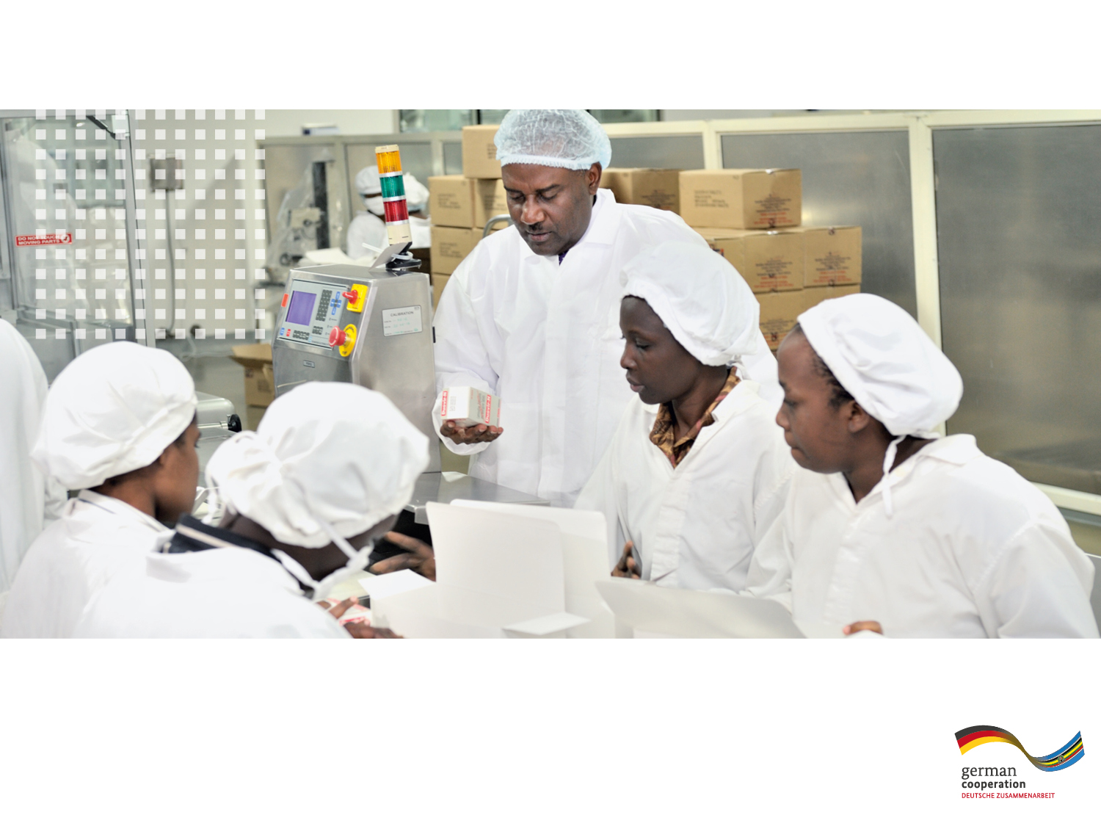


TECHNICAL
COOPERATION
Sub-Saharan Africa
EAC-PTB Project “Establishment of a Quality Infrastructure
for the Pharmaceutical Sector”
Multi-Stakeholders Meeting on Promoting Pharmaceutical Sector Investments in the EAC, Nairobi, 4 November 2016

Slide 2
Outline
PTB and Technical Cooperation
EAC-PTB Project “Establishment of a regional Quality Infrastructure for the pharmaceutical sector in the EAC”
Intervention areas and main activities

Slide 3


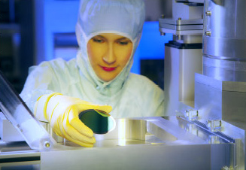
The Physikalisch-Technische Bundesanstalt
The Physikalisch-Technische Bundesanstalt (PTB), the national metrology institute
of Germany has existed for over 125 years.
With 2000 employees located at Braunschweig and Berlin, it is a global player in the world of metrology.
Technical Cooperation
For 50 years, PTB has shared its core competence in international development cooperation. We support developing and emerging economies in the comprehensive field of quality infrastructure. Quality infrastructure is a network consting of various institutions that provide services to comply the compliance of products and services with the national and international guidelines.

Slide 4
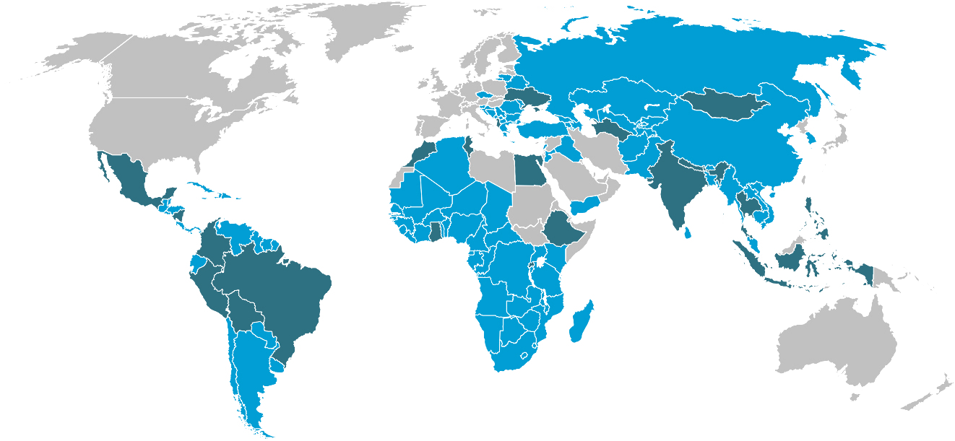
Our Project Partners. Worldwide.
50 projects in 90 countries
of which: 24 are bilateral projects
25 are regional projects
1 is a supra-regional project
Financial volume € 8 – 10 million annually
60 employees
Clients: BMZ, BMWi, EU, development banks, and direct orders
bilateral
regional

Slide 5
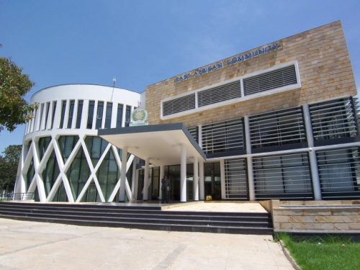
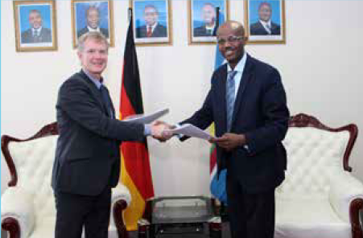
EAC-PTB Project
Part of German Program “Support of the EAC Integration Process” (implemented by GIZ)
Objective: The quality infrastructure in the EAC has been adapted to fit the needs of the Pharmaceutical Sector
Implementation Partner: EAC Secretariat (Department for Health and Department for Industry). Cooperation and coordination with all other development partners of the EAC Secretariat in the pharmaceutical sector
Main project stakeholders: NMRAs (in particular NQCLs), FEAPM, Metrology Institutes,
Budget: 1st term: 1.5 Mio Euro (2013-2016), 2nd term: 1.5 Mio Euro (2016-2019)

Slide 6
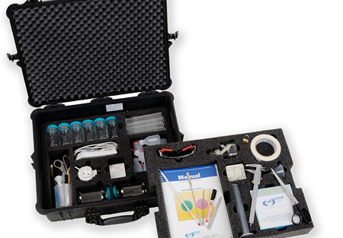
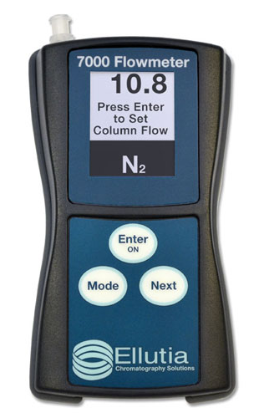
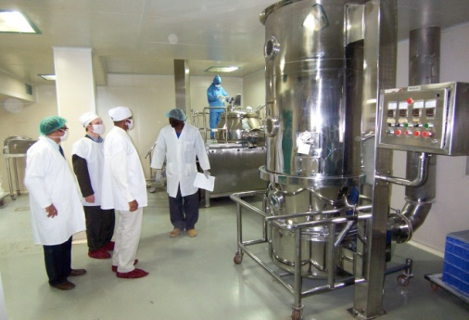
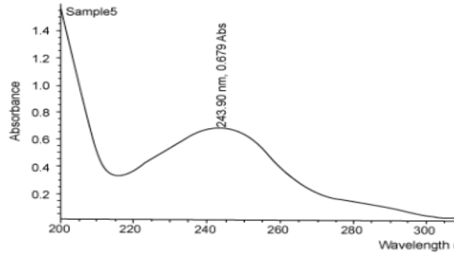
Intervention Areas
Proficiency Testing Schemes
Post-Market Surveillance
Capacity Building regarding quality standards
Chemical Reference Substances
Calibration Services

Slide 7
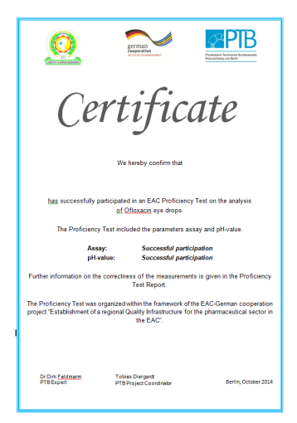
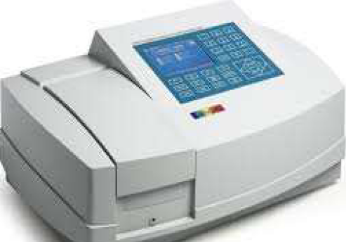
Proficiency Testing Schemes
13 laboratories participated successfully in Amoxycillin PT (tablets) in 2013.
15 laboratories participated successfully in Ofloxacin PT (liquid) in 2014.
17 laboratories participated successfully in PT on Paracetamol by UV method organised by Muhumbili University and facilitated by PTB.
Currently PT on Quinine Sulphate in tablet using Titration method. Final workshop in two weeks in Dar Es Salaam
Target: Muhumbili University becomes accredited to ISO 17043 and offers regular PTs for the region

Slide 8

Post Market Surveillance
Situation Analysis on post market surveillance systems in the EAC by Experts from the UK and Tanzania in 2014
Faciliation of regional working group meetings on Post-Market Surveillance Systems to discuss a regional PMS strategy and protocols
Purchase of GPHF-Minilabs for Rwanda, Burundi and Zanzibar and organisation of Training
Target: Approved regional PMS strategy and regular joint PMS activities

Slide 9
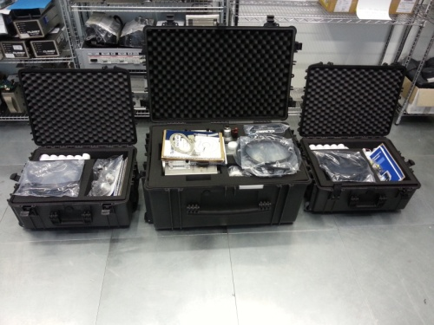
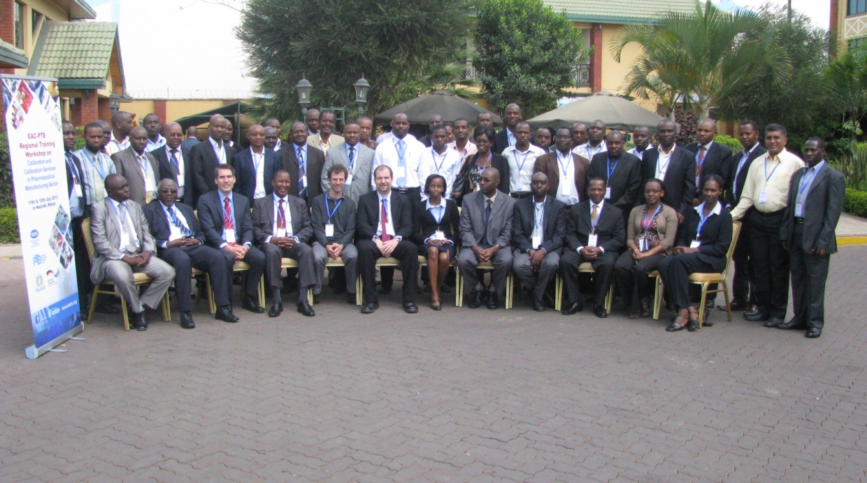
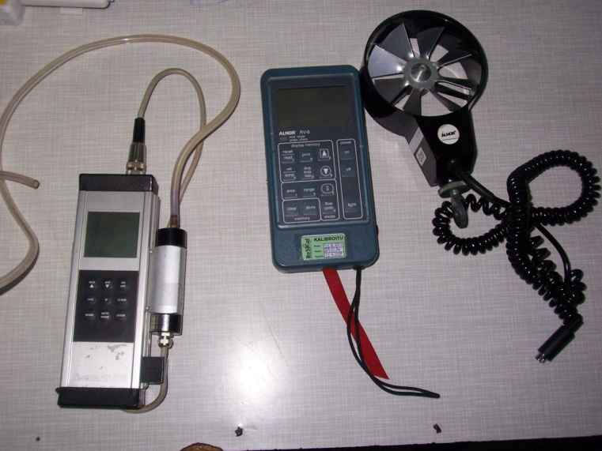
Calibration of Equipment
Purchase of calibration equipment for National Metrology Institutes (NSBs) in partner states
  . Particle Counter Calibration System, Anemometer calibration system, UV light calibration
Metrology Seminars and Training
  Participants from all partner states. Private and public sector
  Awareness raising on need for calibrations.
  Practical Training at a local company. Training on measurement uncertainties
  Target: NMIs offer regional available and affordable calibrations for most measuing equipment used in the pharmaceutical sector

Slide 10
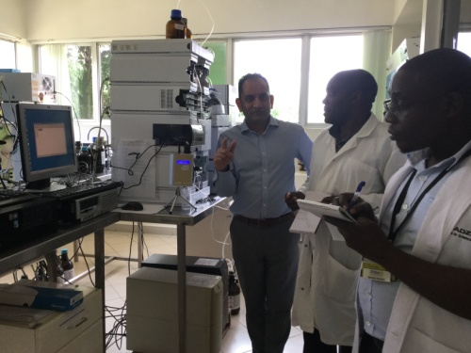
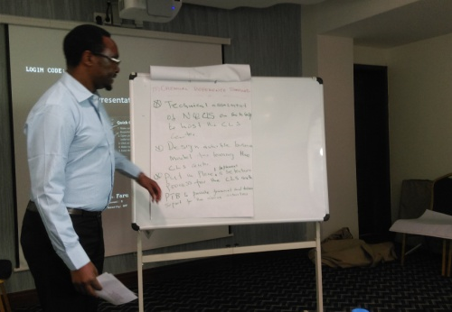
Capacity Building regarding quality standards
Regional Workshops on Validation of Analytical Methods, on Risk Management, and on Planning of Audits
All trainings have been for laboratory staff from QC labs of NMRAs and for pharmaceutical manufacturers
Involvement of regional trainers
Different training workshops on preventative maintenance of HPLCs, Gas Chromatography, UV-VIS Spectrometer and purchase of flow meters for validation of HPLC and GC of QC laboratories
Target: Offering advanced GMP trainings on specific technical aspects like e.g. HVAC validation, Put more emphasis on Training of Trainers, Establishment of a formalized maintenance training course

Slide 11
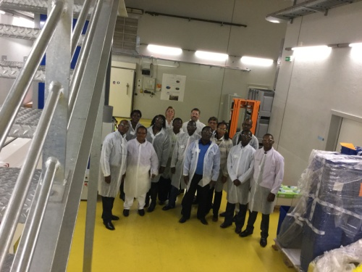

Chemical Reference Substances
Initial Fact Finding Mission with experts from the UK, Germany and Uganda
Study Visits to CRS Centre in ASEAN region and to EDQM in France
Development of a Concepte Note for the Establishment of a CRS Centre in the EAC
Call for Expression of Interest from Partner States to host the Centre as part of an established laboratory
Target: EAC Centre for the Provision of CRS is established

Slide 12
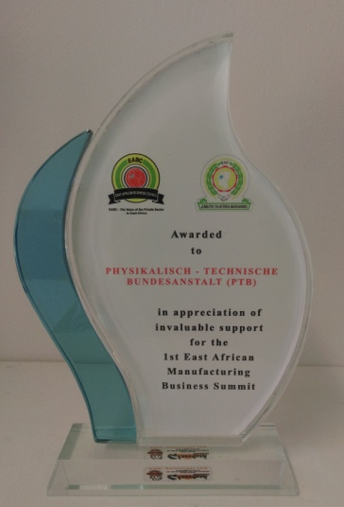

Awareness activities
Support for organising EAC conferences and workshops
5th Annual EA Health and scientific conference. Symposium: Medicines and Food Safety. Kampala
1st EA Manufacturing Business Summit. Kampala
Dissemination WS on the EAC health projects and programs for the Health sector stakeholders. Nairobi
WS to develop EAC Multi-Project Proposal on improving access to medicines and health technologies. Entebbe
1st International Conference on promoting EA Pharmaceutical Sector invesments.

Slide 13
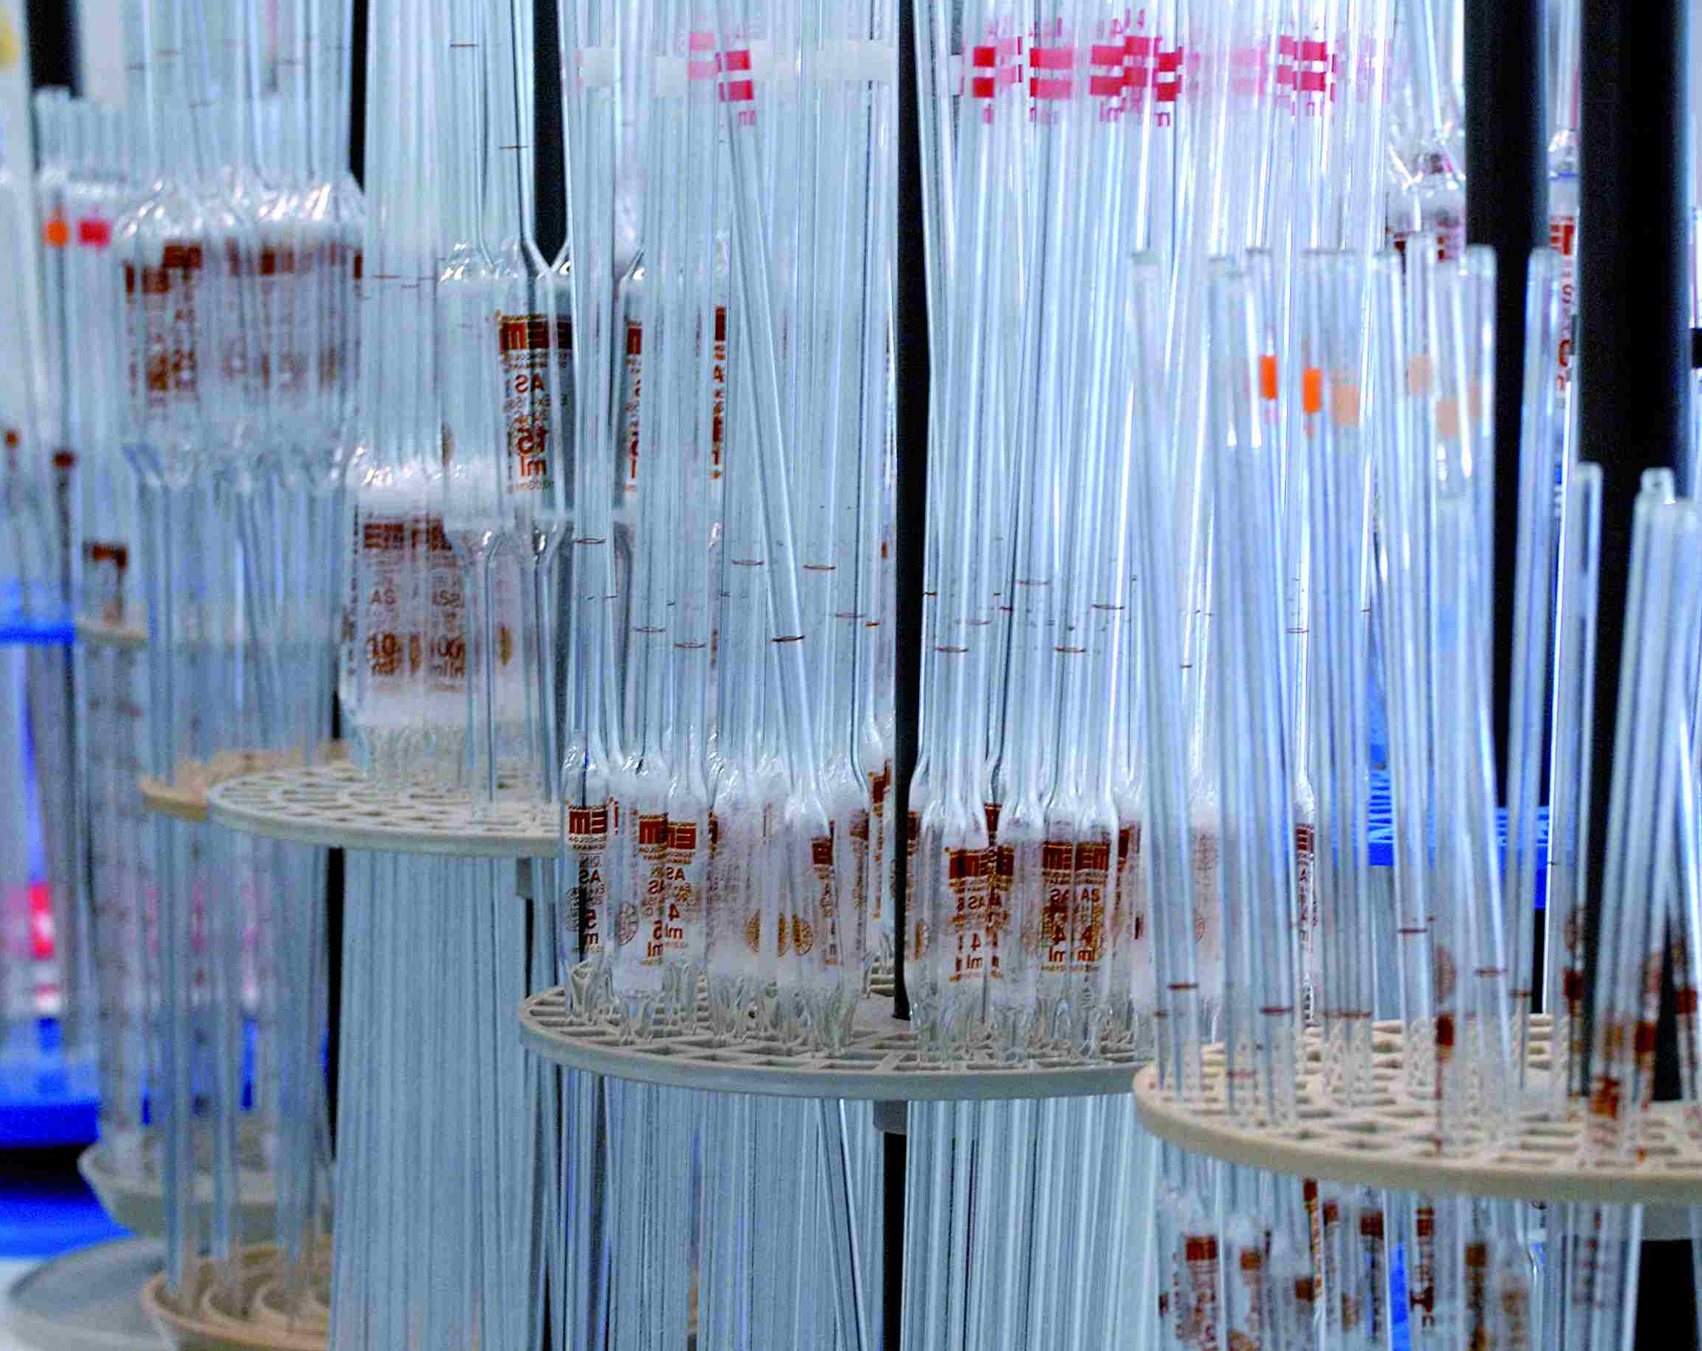
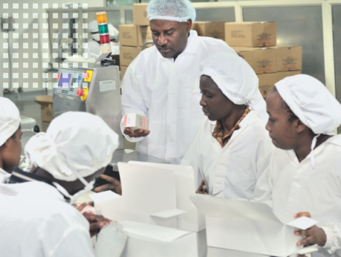

Summary
Beneficiaries and implemen-tation partners
Quality Control Laboratories
Pharmaceutical manufacturers
FEAPM
National Medicines Regulatory Agencies
National Metrology Institutes
Expected Outputs
  Establishment of local accredited Proficiency provider
  Formalized Training on maintenance and repair of laboratory equipment
  Regional staff and trainers are trained on specific GMP aspects (e.g validation HVAC)
  Support establishment of center for CRS in the EAC
  Develop PMS strategy and protocol, Provision and training on Minilabs
  Introduce new calibration services

Slide 14

TECHNICAL
COOPERATION
Thank You Very Much For Your Attention.
© PTB Q.5

