Slide 1
Investing in EA Pharmaceutical Manufacturing Sector
1st International High Level Multi-Stakeholder Conference
Robert M. Karanja, PhD
Co-founder & CEO, Villgro Kenya
Impact Investment for Global Health Innovations

Slide 2
What we do
Villgro Kenya supports global health innovation thro’ social entrepreneurship and impact investment
We de-risk impact investment for global health technologies thro’ early stage “high-touch” incubation:
  IP and innovation management
  Value preposition & business model validation (fail fast, fail safe)
  Go to market and demand-creation strategies
  Regulatory approval & policy/advocacy support
  Fund raising for product development, launch & scale
We promote vibrant healthcare and life sciences innovation system in the EA region

Slide 3
Making the case for health sector paradigm shift from donor driven to sustainable development: the role of local pharma manufacturing in the SocEnt & ImpInv sector

Slide 4
Financial (ROI) opportunity
East African countries (including Kenya) have the fastest economic growth in Africa of >5% with a growing middle class
Growing Pharmaceuticals Market: KES73.34bn (USD746mn) in 2015 to KES83.97bn (USD806mn) in 2016; 14.5% growth in local currency terms and 8.0% in US dollar terms
Growing Healthcare Market: KES341.15bn (USD3.47bn) in 2015 to KES377.09 (USD3.62bn) in 2016; 10.5% growth in local currency terms and 4.3% in US dollar terms
Source: BMI Kenya Pharmaceuticals & Healthcare Report
Notes:
http://store.bmiresearch.com/kenya-pharmaceuticals-healthcare-report.html

Slide 5
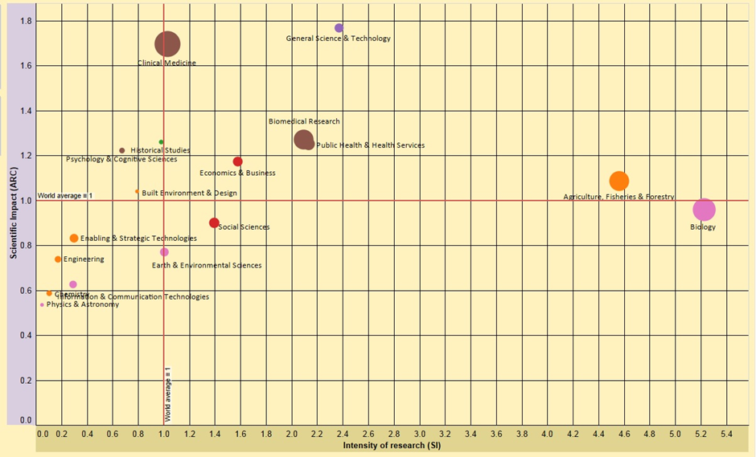
Relatively strong R&D and production capacity
EAC pharma production info:
Vibrant local pharma manufacturing in EAC
Highest pharma sales growth in Africa with est CAGR of 12.4% and market value of USD 5.3 billion
Supplying only 30% of the domestic market
50% idle manufacturing capacity
KENYA’S SCIENTIFIC PRODUCTION: 2005 - 2010
Source: African Observatory of Science Technology & Innovation (AOSTI)
Notes:
Kenya’s scientific production (2005-2010). Quality of national scientific output across all disciplines as measured by the impact factor of peer reviewed publications is presented on the y-axis, and the intensity of research as measured by the volume of publications is presented on the x-axis. Healthcare and life sciences research (blue arrows) present the largest research output (size of dots) and predominantly occupy the top right quadrant that demarcates above world average performance for Kenya’s volume of research output per capita and its quality. ICT (red arrow) shows small size output that is below global average for quality and volume of research. Despite a relatively weak position in terms of scientific output, ICT’s is an unrivalled science, technology & innovation success story of social impact and economic development that has so far eluded the well endowed healthcare and life sciences.

Slide 6
The leap frogging opportunity
Emerging economies have at their disposal multiple disruptive technological innovations, alternative operating models, and behaviour change initiatives that were not available for developed economies when they first began to address NCDs.
Emerging economies are managing larger investments in health than ever before, and they will have to make forward-thinking choices about how to allocate these additional resources.
  In 2014, emerging economies contributed 23 percent to global health expenditures, up from 10 percent in 1995,
  Expenditures expected to reach 33 percent by 2024—a $4 trillion investment per year.
Most emerging economies unencumbered to invest in new solutions since they have fewer sunk costs of existing infrastructure and equipment, lower fixed costs from building overcapacity, weaker vested interests, and a less divided public opinion (as compared to developed economies).
Source: World Economic Forum Report (2016) “Health Systems Leapfrogging in Emerging Economies”
Notes:
Examples: Veripad startup that is democratizing post market surveillance (PMS) through a paper-based POC diagnostic for screening of substandard drugs at the “street level” where even the public can test the quality of drugs for themselves!

Slide 7
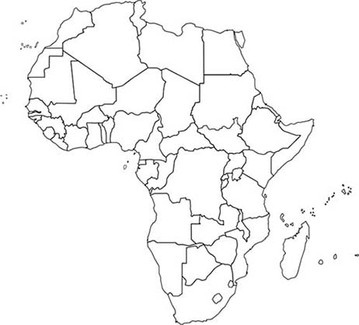
The social impact opportunity
Sub-saharan Africa accounts for about 11% of the world’s population, BUT:
  bears an uneven 24% of the global disease burden
  Including 44% of the world’s communicable diseases
  About half of the world’s deaths of children under 5 take place in Africa

Slide 8
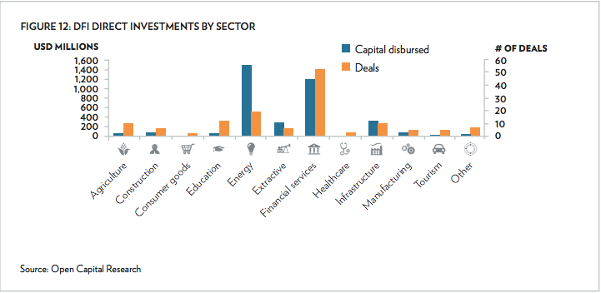
… and Nairobi’s emergence as global a SocEnt & ImpInv hub
Notes:
Development finance institutions (DFIs) are a significant player in the market, having deployed nearly $8 billion in impact capital to date. However, many other types of investors—including VC/PE funds, foundations, family offices, commercial banks, and angel investor networks—are increasingly active, with these non-DFI impact investors having deployed over $1.4 billion to date in the region through more than 550 deals.

