Slide 1
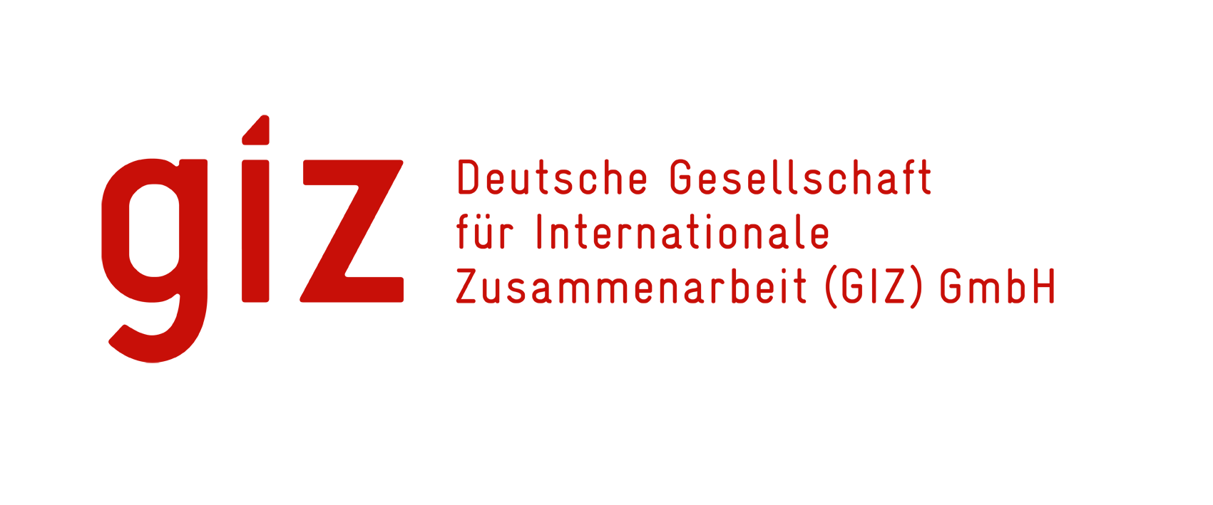

1st International High Level Multi-Stakeholders Meeting on Promoting Pharmaceutical Sector Investments in the East African Community (EAC)
Exploring Innovative Mechanisms for Financing Local Manufacturing
Mr. Amitabh Mehta
Innovative Financing Solutions, Fundraising Strategy & Corporate Partnerships, Nairobi 3rd November 2016

Slide 2
Is there a lack of financing?
Recent study on Local Manufacturing of Vaccines in Africa looked at the question of financing and available finances:
Finance is available, but not necessarily ACCESSIBLE.
How do you tap into that?
  Making projects financially investable/ bankable
  Diversification of the financing source to minimise cost
  Leveraging of existing finances

Slide 3
Innovative mechanisms: Definition
Innovative financing mechanisms, in general, must provide for the following:
  Sustainability
  Predictability
  Transparency
  Leverage
  Partnerships
Models that:
  Can maximize impact and potentially generate returns for investors;
  Engage a new tier of investor in terms of both financial capacity and risk appetite for financial products across asset classes;
  Diversify financing to reduce risk.

Slide 4
Innovative mechanisms
Advance Market Commitments (AMC): Fund structure designed to catalyse investments, from a mixture of government/ public funding with a possibility of other sources of funding – Private, Foundations, CSR.
Revolving Fund: Multi-sourced, diversified capital structure.
Bond/ Loan structure using capital markets to finance, with government/ public sector commitments backing the borrowing.
Private partners including suppliers JVs and upstream integration.
Social Impact Bonds: PPP Structures with risks being transferred to private investors/ capital markets/ individuals. Returns driven and impact investment.
Social Impact Funds: Private Fund structure with a public and private investor base, possibility of leverage from development banks/ loans. Returns and revenue driven.
Islamic Financing/ CSR: Corporate sector funding, unlocked often using public sector incentives.
New donors, Bilateral Funding and Philanthropy +++++++++

Slide 5
Advanced Market Commission (AMC)
Defined: A promise or agreement to take some future action. For example, a promise by a buyer to purchase goods at a price set beforehand is an advance commitment. By removing two important uncertainties – price and demand – from the equation, the mechanism is being hailed by many as the holy grail of spurring development growth.
Structure: A Pharmaceutical Fund, financed by the government and other health organisations where monies would be earmarked for Target Pharma Product Profile (TPPP).
Evidence: The pneumococcal vaccine related AMC is a prime example of a successful use of such a mechanism. In the pilot AMC, donors committed funds to guarantee the price of vaccines once they have been developed.
Points to consider: Volume and pooling, Pre-Qualification, Joint Fund, Leveraging using development banking borrowing (as lower risk), Stimulated Demand and Increased Supply for Revenue generation.
Complementary forces need: to an AMC are critical for creating the enabling environment necessary for its success (e.g. GAVI’s Accelerated Vaccine Introduction initiative, WHO recommendations, GAVI co-financing policy, GAVI’s operational partners), Non revenue driven, Specific use of funds.

Slide 6
Catalytic EAC Pharma Manufacturing Fund (PMF) - PPP
Defined: A Revolving PPP Fund designed to provide the 1st layer of risk in order to attract other forms of investment and lending, along the lines of a social impact Fund.
Structure: The aim of the Fund will be to create a transparent, well governed, project catalysing, financing facility that can attract funding from various financing sources that are not sovereign guaranteed.
Evidence: There are several Funds in discussion such as the one being suggested. The creation of such a Fund could have a first mover advantage, be highly innovative (attracting new sources of financing). Local Health Investment Fund is a smaller prototype of this ideology, as is the power of nutrition.
Points to consider:
  Well structured fund able to attract international/ domestic finance sources.
  Strict eligibility criteria for projects based on prioritised need, volumes and a diversified portfolio.
  Commercial rationale for projects to attract private sector.
  Well designed and ready ‘Anchor Projects’ that can seek funding from the Facility to demonstrate success.
  Eco-system in terms of HR institutions, NRAs, Policies, Management, plus infrastructure, incentives.

Slide 7




EAC Pharma Manufacturing Fund (PMF)
Leveraged & Diversified Capital Structure
Management PPP & Investment
Matching funds
Trade and Aid funds
Phlianthrophy
Fund Management Company (PPP)
Professional Fund Manager
Governments (Finance Ministries)
Non-returns Based Funding
Catalytic EAC Pharma
Manufacturing Fund (PMF)
Independent, Bankruptcy-Remote,
Special-Purpose Trust
Leverage Finance
Development/ Commercial Bank
Social Impact/ Pension Funds
Bond/ Corporate Investors
Loans
Repayable from Sales, Take-out Financing
Investment & Advisory
Committee (PPP)
EAC
Governments (Finance/ Health
Ministries)
Pharma Industry
GIZ, UN, WHO
Seed Funding
Governments in the EAC
Organisations – Foundations
PE Funds (GHIF)
Fatigued/ New Donors
Seed-funding
Equity
Shareholding
Shareholdings
Investments
INVESTMENTS IN LOCAL MANUFACTURING
PROJECT 1
PROJECT 2
PROJECT 3

Slide 8
Domestic/ Regional Health Bond Programmes
Defined: Using as a basis the IFFIm model of securitised bonds, there is much discussion if adapted models could be created at the regional or national level to fund manufacturing. Borrowings from the capital markets regionally/ eurobonds potentially to fund manufacturing.
Structure: A securitised regional bond programme, that could be securitised using the guarantees of governments in the EAC, and over-collateralised using the future income flow from revenues of Pharma sales. The bonds would be long term, issued in the local market, with financing raised in the local capital markets.
Evidence: The IFFIm platform, Social Impact Bond Initiatives including bilateral bonds.
Points to consider:
  Securitisation Law unutilised thus far and the depth of domestic and regional capital markets.
  Capital Market appetite and knowledge of risks/ understanding.
  Projections in terms of timing for the project and returns scenarios.
  Size of the borrowing? Capital Markets needs.
  Rating issues and international debt issues.

Slide 9
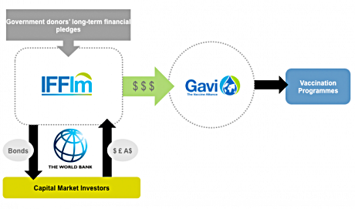
IFFIm Bond Structure
Rapidly accelerate the availability and predictability of funds for immunisation.
Uses international capital markets to raise funding for the purchase of vaccines, by securitising (using as collateral) financial commitments from highly rated governments.
Uses long-term legal commitments from donor governments to issue 'vaccine bonds' in the capital markets (up to 20 years), raising funds (borrowings) immediately available for GAVI programmes, thereby creating the "predictability" that is necessary for long-term budget and planning decisions for programmes.
Refinanced USD 6.5bn backed by legal commitments from the governments.
The 3rd international conference in Addis Ababa in 2015 for financing and development has also backed this mechanism for wider applicability.

Slide 10
Viability Gap Funding
Defined: VGF is effectively a fund set-up by government(s) to supplement returns into a specific priority industry. It serves as a feature to attract further private sector funding.
Structure: No specific structure needed but a corpus fund would be created by the governments typically and earmarked to bridge the GAP between economically justified projects that fall short of financial viability.
Evidence: Several of these exist in the world of infrastructure though not necessarily in health. Solid waste management project in Kampala, Uganda; Highway projects in India, Vietnam Hydropower, Cambodia Renewable Energy.
Issues to Consider:
  Usually limited amount of funding (uptil 20% of the entire project).
  Favorable Terms and Return Profile.
  VGF grants are only disbursed after investors have committed equity to the project, thereby putting their money at risk for a project they believe to be viable.

Slide 11
Bilateral Funding sources
Using East Africa’s strengths to attract funding from growing bilateral trade and bilateral negotiations. Investigate further how to use Africa's unique position as an attractive consumer market to leverage manufacturing relationships and financing:
  Government and Corporate Funding from global Pharma Market.
  Growing retail market.
  Political, population and economic ties.
  Indo-Africa Meet 2015.
India, China, Europe:
  Keen to extend their links to a growing potential market: Retail goods and services
  Keen to utilise their knowledge to increase trade and aid.
  Bilateral funding.
  Keen to extend markets, knowledge, and industry: Pharma, Vaccines.
  Tech Transfer, JV and Funding.
  Trade and Aid Sovereign Funds.
Benefits:
  Understanding of the risks and returns of the market due to ancillary interests.
  Cheaper funding.
  Peripheral benefits such as training of staff and JVs.
  Prior Knowledge.

Slide 12
Other potential mechanisms
Development Banks
Tax Subsidies: Funding through unrelated corporates
Incentive Schemes
Islamic Financing: Sukuk, Cleansing Monies, IsDB initiatives
Philanthropy and new donors (Trade and Aid) from developing countries.

Slide 13
Potential Mechanism Mix - I
One could envisage a production line style of financing, with:
Multilateral Loan: A project platform could seek a multilateral bank loan to allow a mixture of projects to be financed (‘Core’ and ‘Related’).
PDA: A Project Design Advance from the governments/ foundations is envisaged to prepare initial projects and set up a project platform.
The first loan tranche: Could be for a core drug or drugs as identified by experts – which could theoretically use 100% multilateral financing – a PPP arrangement could then mean that the private contractor need not finance any capex and have a revenue model backed by the project platform with assurance to pay possible revenue gaps. Viability GAP funding could also be investigated by governments where the manufacturing will take place.
Other loan tranches: Multilateral funds through later tranches can also be capped at 20-30% of a project to allow for financing from other sources (private sector)– this allows the impact of such funds to be much bigger and catalytic for private and commercial sources.
Non-Sovereign Loan: Some of the underlying manufacturing projects may be developed for bankability.

Slide 14
Potential Mechanism Mix - II
In general, any platform to finance manufacturing must try to include initiatives to tap financing from:
The people that get the most benefit from the services being build – the populace – individual investments from conduits and bonds at the senior level debt lending.
Businesses that stand to benefit from the development – through indirect effects on health and better standard of living.
Businesses that are benefitting from the city.
Allow leveraging of government and public sector equity and budget allocations.
Allow development and commercial banks to contribute in areas and stages of knowledge and risk acceptance.

Slide 15
Next Steps
Concept Notes for discussion, Business/ Investment Case and Mechanisms.
    Specific Pharma drugs
    Specific hubs/ geographical locations
    Specific Instruments Appetite
Knowledge dissemination for greater understanding of risks.
    Workshops for investors, financiers, multilaterals
    Comparable investment cases
Dialogue with interested stakeholders on finance.
    Suppliers
    Developing Country Vaccine Manufacturers
    Sovereigns (Africa-India, Africa-China, Africa-EU)
    Multi-laterals, specific initiatives: AfDB, IsDB Pharma Initiatives

Slide 16

Thank you
AMITABH MEHTA
Director: Innovative finance, strategy
INDUS BLUE CONSULTING
6 RUE PRADIER
GENEVE 1201 mehta@gmx.ch
SWITZERLAND 41 (0) 7622 80 757
IN CONSULTATION WITH, AND SUPPORTING THE WORK OF THE :

