Slide 1
Topic: Promoting growth of local manufacturing industry: Lessons from other sectors’
Presenter: Emmanuel Alenga Makheti

Slide 2
Contents
Input side interventions.
Output interventions
Consideration by Stakeholders

Slide 3
Principles of EAC Industrialization Policy
Equitable industrialization
Exploiting policy synergies
Strengthen industry linkage between large and MSMEs
Promoting targeted industry value chains
Enhancing skills and knowledge for industrialization
Predictable role of Partner State and EAC Institutions
Market led approach to industrialization
Notes:
It is possible to apply this template to exiting presentations.
Have the latest presentation template open
Click on the View tab and select Normal
Delete all unwanted slides
Click on the Insert tab from the menu bar and select Slides from Files
Click on Browse. Navigate to the presentation you wish to update with the new template. Highlight the presentation and click Open
Wait for the slides from the presentation to load and click on Insert All. Then click Close
Check the inserted slides to ensure that the most appropriate master slide has been used on each slide
To change the master applied to a slide select the slide you wish to apply a different master to then click on the Format tab from the menu bar and select Slide Design
From the Used in This Presentation section choose the master you wish to apply to the slide and hover over it to reveal a drop-down arrow. Click on the arrow and select Apply to Selected Slides
It is important to thoroughly check the presentation to ensure that no further formatting is needed.

Slide 4
Introduction
Pharmaceutical Manufacturing a key contributor to MVA
Priority Sector – EAC Industrialization Policy 2012 – 2032
“Structural transformation…high value addition…product diversification….comparative and competitive advantage.”
Other manufacturing sub-sectors 14
What lessons can we draw from interventions in other sectors to grow manufacturing industry?
  Food and Beverage
  Metal and Allied
  Textile and Apparel
  Leather and Footwear
  Paper and Board
  Timber, Wood and Furniture
  Motor Vehicle Assembly and Accessories
  Plastics and Rubber
  Building, Mining & Construction
Notes:
It is possible to apply this template to exiting presentations.
Have the latest presentation template open
Click on the View tab and select Normal
Delete all unwanted slides
Click on the Insert tab from the menu bar and select Slides from Files
Click on Browse. Navigate to the presentation you wish to update with the new template. Highlight the presentation and click Open
Wait for the slides from the presentation to load and click on Insert All. Then click Close
Check the inserted slides to ensure that the most appropriate master slide has been used on each slide
To change the master applied to a slide select the slide you wish to apply a different master to then click on the Format tab from the menu bar and select Slide Design
From the Used in This Presentation section choose the master you wish to apply to the slide and hover over it to reveal a drop-down arrow. Click on the arrow and select Apply to Selected Slides
It is important to thoroughly check the presentation to ensure that no further formatting is needed.

Slide 5
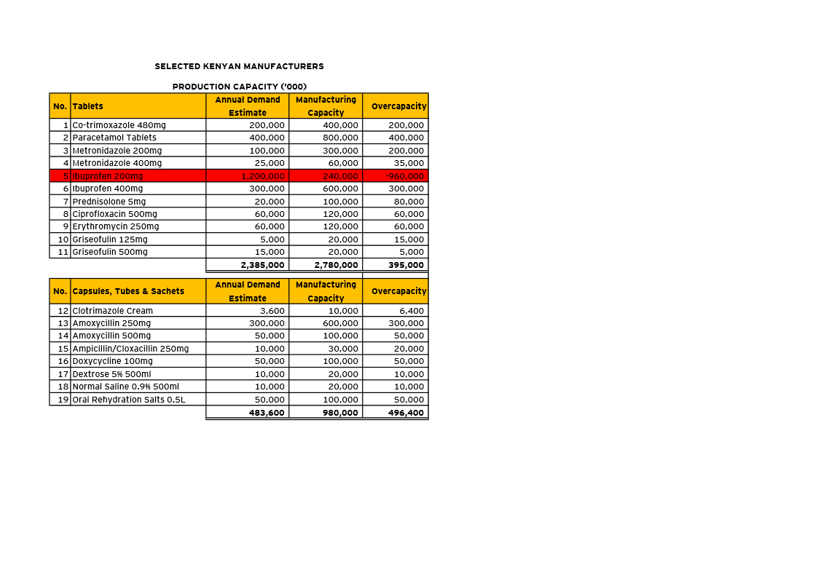
Production Capacity
Source: FKPM

Slide 6
Continued
Consideration for Local Manufacture
Valproic Acid (Sodium Valproate) Tablets 200mg
Activated Charcoal Tablets

Slide 7
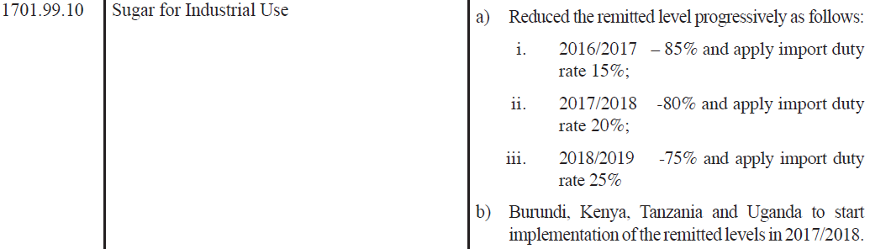
Access to Raw Materials
Guarantee of raw material, intermediate products and packaging material.
Packaging Material – Primary, Secondary
Raw material:
  API, excipients
  Sugar for Industrial Use;
Notes:
It is possible to apply this template to exiting presentations.
Have the latest presentation template open
Click on the View tab and select Normal
Delete all unwanted slides
Click on the Insert tab from the menu bar and select Slides from Files
Click on Browse. Navigate to the presentation you wish to update with the new template. Highlight the presentation and click Open
Wait for the slides from the presentation to load and click on Insert All. Then click Close
Check the inserted slides to ensure that the most appropriate master slide has been used on each slide
To change the master applied to a slide select the slide you wish to apply a different master to then click on the Format tab from the menu bar and select Slide Design
From the Used in This Presentation section choose the master you wish to apply to the slide and hover over it to reveal a drop-down arrow. Click on the arrow and select Apply to Selected Slides
It is important to thoroughly check the presentation to ensure that no further formatting is needed.

Slide 8
Common External Tariff (CET)Structure
Schedule 1: CET Bands 0% Raw Material; 10% Intermediate; 25% Finished Product
Schedule 2: Sensitive List
Basis of CET
Value Addition
Basis of Sensitive List
Goods of strategic economic importance
Policy objectives of the partner states government → EAC Policy
Sustain local manufacturing industries and farmers from imported products that could hamper their growth.
Tripartite FTA COMESA-SADC-EAC
NO pharmaceutical product locally manufactured listed in sensitive list.
Notes:
It is possible to apply this template to exiting presentations.
Have the latest presentation template open
Click on the View tab and select Normal
Delete all unwanted slides
Click on the Insert tab from the menu bar and select Slides from Files
Click on Browse. Navigate to the presentation you wish to update with the new template. Highlight the presentation and click Open
Wait for the slides from the presentation to load and click on Insert All. Then click Close
Check the inserted slides to ensure that the most appropriate master slide has been used on each slide
To change the master applied to a slide select the slide you wish to apply a different master to then click on the Format tab from the menu bar and select Slide Design
From the Used in This Presentation section choose the master you wish to apply to the slide and hover over it to reveal a drop-down arrow. Click on the arrow and select Apply to Selected Slides
It is important to thoroughly check the presentation to ensure that no further formatting is needed.

Slide 9
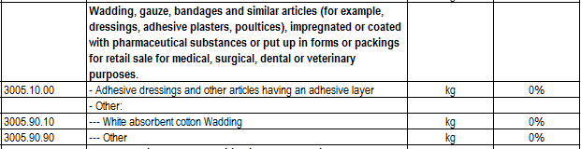
Common External Tariff Structure …Cont
CET Bands 0% Raw Material; 10% Intermediate; 25% Finished Product
Increased importation of finished products.
Chapter 30 tariff lines rate at 0% import duty rate except waste pharmaceuticals 25% India 425 lines
Review of Common External Tariff to reflect manufacturing sector needs.
Notes:
It is possible to apply this template to exiting presentations.
Have the latest presentation template open
Click on the View tab and select Normal
Delete all unwanted slides
Click on the Insert tab from the menu bar and select Slides from Files
Click on Browse. Navigate to the presentation you wish to update with the new template. Highlight the presentation and click Open
Wait for the slides from the presentation to load and click on Insert All. Then click Close
Check the inserted slides to ensure that the most appropriate master slide has been used on each slide
To change the master applied to a slide select the slide you wish to apply a different master to then click on the Format tab from the menu bar and select Slide Design
From the Used in This Presentation section choose the master you wish to apply to the slide and hover over it to reveal a drop-down arrow. Click on the arrow and select Apply to Selected Slides
It is important to thoroughly check the presentation to ensure that no further formatting is needed.

Slide 10
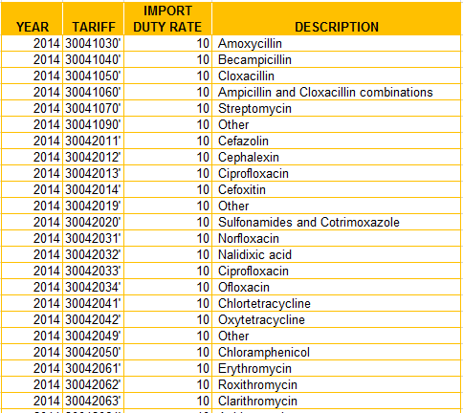
India CET Structure
Source: WTO
Notes:
It is possible to apply this template to exiting presentations.
Have the latest presentation template open
Click on the View tab and select Normal
Delete all unwanted slides
Click on the Insert tab from the menu bar and select Slides from Files
Click on Browse. Navigate to the presentation you wish to update with the new template. Highlight the presentation and click Open
Wait for the slides from the presentation to load and click on Insert All. Then click Close
Check the inserted slides to ensure that the most appropriate master slide has been used on each slide
To change the master applied to a slide select the slide you wish to apply a different master to then click on the Format tab from the menu bar and select Slide Design
From the Used in This Presentation section choose the master you wish to apply to the slide and hover over it to reveal a drop-down arrow. Click on the arrow and select Apply to Selected Slides
It is important to thoroughly check the presentation to ensure that no further formatting is needed.

Slide 11
Comparative Advantage
Uganda
Mannitol
Tanzania
Kenya
Betamethasone
Cetrizine
Chloramphenicol
Chlorpheniramine
Gentamicin
Prednisolone
Acetaminophen
Albendazole
Amoxicillin
Ampicillin

Slide 12
Graduate Training
39B Set-off tax rebate for apprenticeships Finance Act, 2015 effective 1st Jan 2016
Any employer ….ten university graduates as apprentices…period of six to twelve months …tax rebate in the year subsequent to the year of such engagement.
Income Tax (Set-off Tax Rebate for Graduate Apprenticeships) Regulations 2016 effective 1st April 2016
“…fifty percent of the amount of salaries and wages paid to at least ten apprentices.”

Slide 13
Quality of RM and Finished Product
GMP Certification: Personnel, Facilities, Equipment, Materials, Manufacturing operations, Labelling, Packaging, QC and Stability Testing
Import Duty Exemption of HVAC Equipment of 8415.82.00 and 8415.83.00
Route C: manufacturers demonstrate existence of a QMS in their production/ manufacturing process.
Route | Ad Valorem Fee % of FOB |  |  | Min – Maximum Fee US$
 | URT | KEN | UG | URT | Kenya | UG
A | 0.53 | 0.50 | 0.50 | 250 – 7,000 | 250 – 2,675 | 235 – 3,000
B | 0.45 | 0.45 | 0.45 | 250 – 7,000 | 250 – 2,675 | 235 – 3,000
C | 0.25 | 0.25 | 0.25 | 250 – 7,000 | 250 – 2,675 | 235 – 3,000

Slide 14
…Cont
Section 24 of the Standard Quality Assurance, Metrology and Testing (SQMT) Act provides:
“…shall recognize as equal to their own, product certification marks awarded by national quality system institutions of other partner states...."
EAC Standardization, Accreditation and Conformity Assessment (SACA) Bill 2016 under S24 retains spirit of provision.

Slide 15
Value Added Tax
Current Kenyan Tax Structure
Zero Rated: Inputs or raw materials (either produced locally or imported) supplied to pharmaceutical manufacturers in Kenya for manufacturing medicaments FA 2015
Zero Rated: Most medicament under tariff heading 3002, 3003, 3004
Issues
List of inputs may require revision;
Need for automation of the local exemption process;
Some medicaments still exempt: Heparin, Other human or animal substances...therapeutic or prophylactic use, Medicament containing insulin
Solutions
Harmonize the VAT structure across partner states. 70% of pharmaceutical exports destined to EAC.
Tax refunds
Notes:
It is possible to apply this template to exiting presentations.
Have the latest presentation template open
Click on the View tab and select Normal
Delete all unwanted slides
Click on the Insert tab from the menu bar and select Slides from Files
Click on Browse. Navigate to the presentation you wish to update with the new template. Highlight the presentation and click Open
Wait for the slides from the presentation to load and click on Insert All. Then click Close
Check the inserted slides to ensure that the most appropriate master slide has been used on each slide
To change the master applied to a slide select the slide you wish to apply a different master to then click on the Format tab from the menu bar and select Slide Design
From the Used in This Presentation section choose the master you wish to apply to the slide and hover over it to reveal a drop-down arrow. Click on the arrow and select Apply to Selected Slides
It is important to thoroughly check the presentation to ensure that no further formatting is needed.

Slide 16
Preferential Treatment
Section 155 of the Public Procurement and Disposal Act
“Subject to….applicable international or local standards, only such manufactured articles, materials or supplies in Kenya…shall be subject to preferential procurement.”
Section 157 (9) all foreign tenderers participating in international tenders to source at least forty percent of their supplies from citizen contractor
Order of Preference
manufactured articles, materials and supplies produced/mined in Kenya; or
firms where Kenyans are shareholders
Expand local content provision to the regional level; BEABEA
Track enforcement of PPDA by PEs.
    Independent Observers in Evaluation Committee
Notes:
It is possible to apply this template to exiting presentations.
Have the latest presentation template open
Click on the View tab and select Normal
Delete all unwanted slides
Click on the Insert tab from the menu bar and select Slides from Files
Click on Browse. Navigate to the presentation you wish to update with the new template. Highlight the presentation and click Open
Wait for the slides from the presentation to load and click on Insert All. Then click Close
Check the inserted slides to ensure that the most appropriate master slide has been used on each slide
To change the master applied to a slide select the slide you wish to apply a different master to then click on the Format tab from the menu bar and select Slide Design
From the Used in This Presentation section choose the master you wish to apply to the slide and hover over it to reveal a drop-down arrow. Click on the arrow and select Apply to Selected Slides
It is important to thoroughly check the presentation to ensure that no further formatting is needed.

Slide 17
Local Effective Demand
Private
Public – KEMSA primary public medicine procurement agency KEMSA DATA 2015/16 Extract
Pharmaceutical Description | Unit Price (US$) | Unit of Measure | Total Amount | Supplier Awarded
Folic Acid T. | 3.8 | 27,100 | 102,980 | Laboratory & Allied
Albendazole T. | 5.6 | 19,560 | 110,084 | Biodeal Laboratories
Erythromycin | 18.75 | 21,400 | 401,250 | Elys Chemical Industries
Griseofulvin Tablets | 17.35 | 13,405 | 232,576 | Universal Corporation
Ciprofloxacin Tablets | 12.40 | 25,678 | 318,518 | Cosmos Pharmaceuticals
Cpd Magnesium Trisilicate | 2.06 | 31,616 | 65,263 | Regal Pharmaceuticals
TOTAL | US$ 4,671,123.48 |  |  | LOCAL MANUFACTURER

Slide 18
Market Erosion – Counterfeit Products
Common Medicine part of list of most counterfeited products - ACA.
Kenya National Pharmaceutical Policy 2008 (Page 16)
Progress to fully fledged customs union commendable – border porosity
Regional legislation against counterfeit (NOT generic) products.

Slide 19
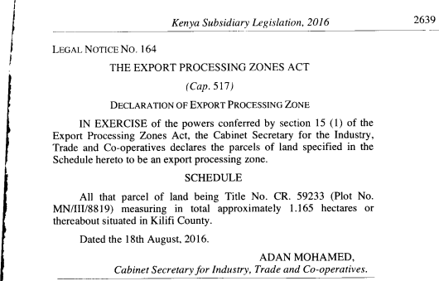
Incentive Schemes – Special Economic Zone
Integrated infrastructure facilities; removal of impediments to economic and business activities.
Special Economic Zones Act exempt SEZs from:
    Income Tax
    Import Duty
    VAT (zero rated)
    Excise Duty
Any existing facility can be
gazetted
RDL applicable except on
industrial parks 100 acres

Slide 20
Donor Funded Project
EAC Customs Management Act Goods and Equipment for Use in Aid Funded Projects
Kenya: Import duties, IDF, RDL, and excise duty exemption
Government Contract Agreements
Kenya Manufacturers pay
1.5% RDL and 2.0% IDF of
the customs value.
Section 4(2) of PPDA explicitly excludes official aid funded projects from its scope
Inculcate and enforce local content requirement in specific clauses
SADC has developed regional strategy to promote sourcing of regional goods and services by donor agencies
  “Address a need – Impact,
  Specific clauses”.

Slide 21
Way Forward
(a)
Review EAC CET considering value add contribution by established manufacturers;
(b)
Remit 100% import duty on sugar for industrial use by pharmaceutical manufacturers;
(d)
Harmonization of EAC Partner states domestic taxes;
(c)
Harmonize and enforce regional procurement preference and reservation provisions;
(e)
Fairly implement Special Economic Zone Act to sustain existing industries;
(f)
Finalize and implement an EAC Regional Anti-counterfeit Policy and Law;
Pharmaceutical Industry investment in graduate trainees.
(h)

Slide 22

Questions??

Slide 23
THE END!

