Slide 1

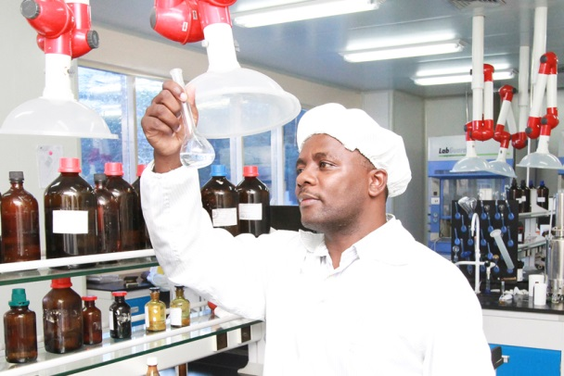
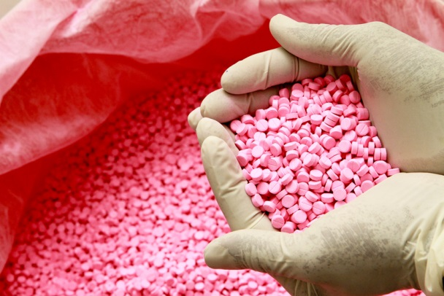
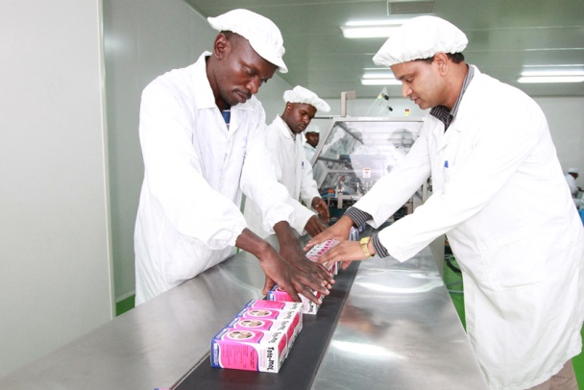
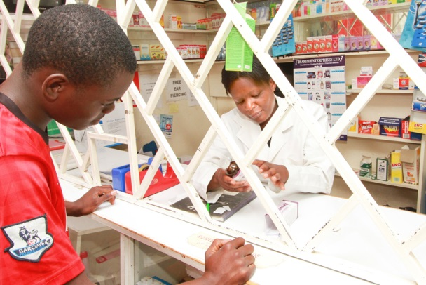
The EAC Pharma Policy Incentive Package
Workshop on Promoting Pharmaceutical Sector Investment In the East African Community
1-3 Nov 2016, Nairobi

Slide 2
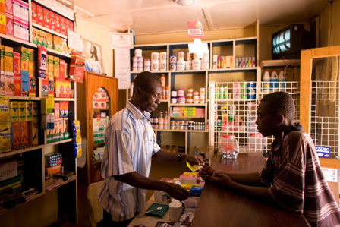


Medicine Miracles or Policy?
In the 1990‘s Ghana was flooded with sub-standard medicines.
In the early 1980‘s Bangladesh faced a public health crisis over high medicine prices.
In 2013, sub-standard malaria medication has decreased from over 30% to only 3%.
In the early 2000‘s, prices for medicines had dropped by more than 50% in real terms.
2
2
Notes:
Idea:
Tell a story – We have two examples where some while ago politicians faced public health issues. When we look at the countries now we see that these problems have been much improved. What happened in the meantime? Obviously, the answer is that they supported the pharmaceutical manufacturing, spell that out in the end.
Thereby, we have one quality arguments (Ghana) and one price argument (Bangladesh), which are both meant to convince a public health person like Sezibera.

Slide 3
Ghana’s Policy: Incentives for Local Production
Corporate tax exemption for 3 years after establishment
Import ban for 44 medicines
VAT exemption
66 of 200 basic materials required for production are exempted from import duty
Local price preference of 15%
Source: GIZ / FEAPM Study
3
3
Notes:
Started in 1989 and constantly expanded, measures are still in place. The FEAPM representatives know that example well and can speak about it

Slide 4
Ghana’s Policy: Outcomes
Local manufacturers increased from
9 to 39
Sub-standard and counterfeit medicines dropped from 40% to 3%
Improved trade balance: medicines imports dropped from 90% to 70%
Increase in employment from 150 to 6,500
Source: GIZ / FEAPM Study
4
4

Slide 5
Bangladesh’s Policy: Incentives for Local Production
Limit import of drugs that are sufficiently produced locally
Price ceilings
Promotion of technology transfer and licensing agreements with foreign partners
Only local manufacturers allowed to advertise
Investment in human capacity development
Source: GRIPS 2013
5
5
Notes:
Part of 1982 NDP.
The government composed a list (like we are doing in EAC) with medicines that are produced in ample capacity and restricted the import of medicines on that list.
Price ceiling came in to mitigate the effect of less competition. We don’t want to allow local manufacturers to simply dictate prices now if we support them. The goal is access to medicines
Government got active in making sure foreign companies contributed to technology transfer once the went into licensing/JV agreements with bangladeshis
There were still imports of outside companies, but they made life hard for them to force them to have at least some kind of production in the country.
Many managers of local companies came from the University of Dhaka which put a lot of emphasis on pharmacy education

Slide 6
Bangladesh’s Policy: Outcomes
Prices decreased by more than 50% in real terms
Local production of essential medicines increased from 30% to 90%
Substandard drugs fell from 36% to 9%
Import savings of USD 600 M
Local API production started
All top 10 firms are locally owned
Sector employs over 100,000
Source: GRIPS 2013
6
6
Notes:
To point 1: real terms means that overall prices increased by 180 % since the NDP and medicine prices by only ca.30% - making them cheaper in relative terms

Slide 7
Why support local manufacturing in the EAC?
    Improve access to medicine
    Boost regional economy

Slide 8
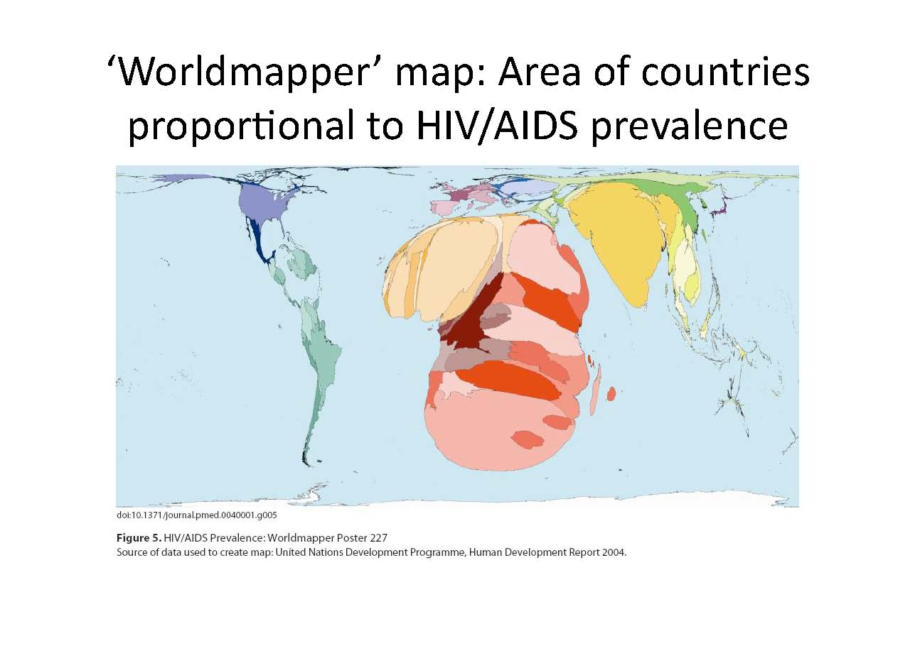
Notes:
If we re-draw the world map based on disease prevalence, we would see Africa in a very different light!!

Slide 9
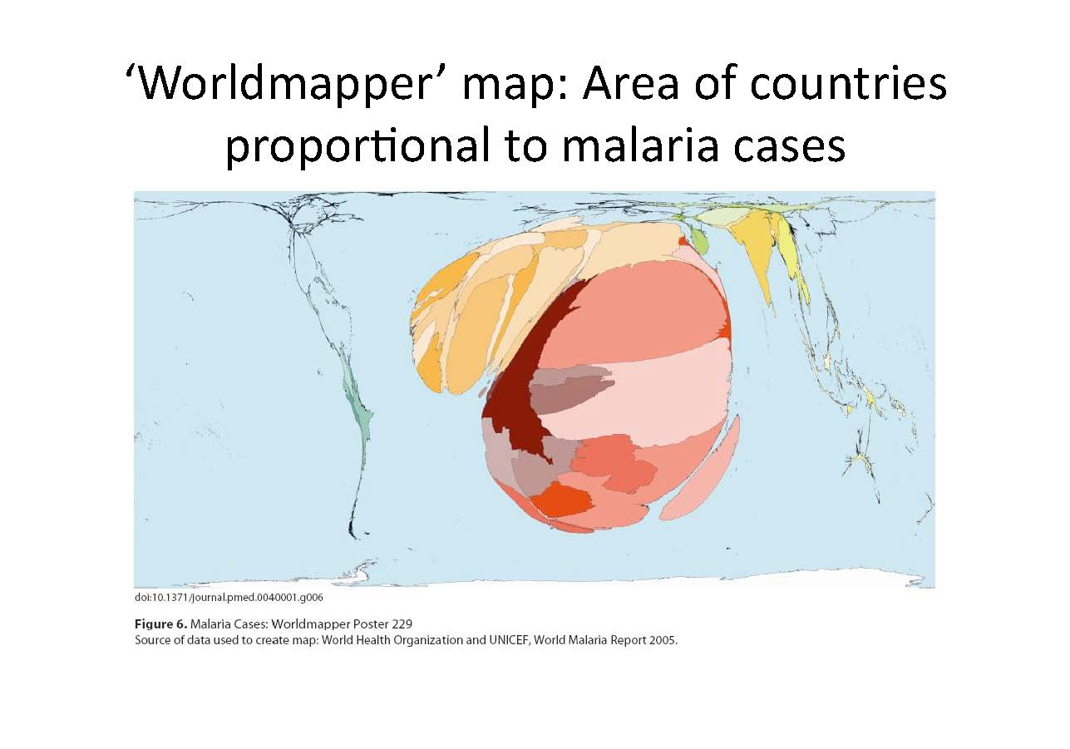
Notes:
In terms of Malaria, Africa really is the centre of the world and strongly dominant!! These are also business opportunities .

Slide 10

Health benefits of local manufacturing
Reduce dependency and improve sustainability
  Donors/MNCs
  Other external sources
Take advantage of TRIPS flexibilities for LDCs to build up own capacities
Increase reliability & quality of supply
  Less stock-outs
  Capacity for emergencies
Increase access & affordability in rural areas
  Adapted distribution networks
  Cater better to local needs
Source: WHO & UNCTAD 2011
8
10
Notes:
Access and affordability in rural areas: Some pharmaceutical companies came from the transport / logistics sector and therefore have great expertise in that field. Local manufacturers know their working environment better than foreign countries. They find creative ways to distribute medicine and know better which type of drugs is truly needed in rural areas.
TRIPS: TRIPS leave LDCs more flexibilities (or transition periods) in terms of patent rights that can be used to build up own capacities.

Slide 11

Economic benefits of local manufacturing
Employment generation
  Opportunities for highly skilled labor force
Spill-over effects
Skills
Technology transfer
Backward / forward linkages
Import savings
  Long-term:
  Export earnings
High value industry
  Attracts investments
  High financial viability
Source: WHO & UNCTAD 2011
9
11
Notes:
Foreign export earnings is a long-term goal that will be reached when EAC companies start to export medical products.
Spill-over effects: include technology transfer, but also the transfer of skills to other parts of the economy that have been achieved within the pharmaceutical sector. Downstream effects are the additional jobs and industry segments like packaging, transport, logistics in general, storage etc. through a vibrant pharmaceutical sector. This creates a vertical integrated value chain.
High value industry: The pharmaceutical sector has high margins of profit, that means that investments in this sector leads to high returns and therefore profitability.

Slide 12
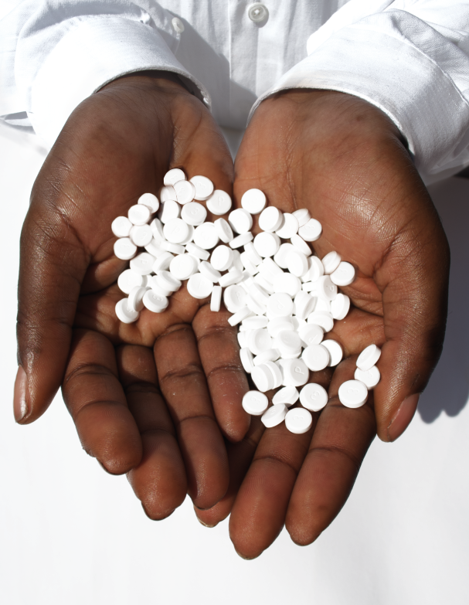
Strategic Analysis:
The (future?) pharmaceutical sector in the EAC

Slide 13
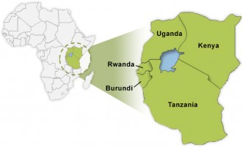
Local Production in the EAC
Imports
75%
6
22
1
25%
1
4
Local production
34 facilities (members of FEAPM)
2 facilities with WHO cGMP approval and Pre-Qualified products
40-50% capacity utilization
11
13

Slide 14

Regional Challenges
Weak physical & quality infrastructure
There is improvement in the areas of testing,
surveillance and laboratories being done. Need to increase capacity of RA’s
Scarcity of appropriately trained technical staff
EAC is a potential large talent pool.
Expand industrial pharmacy training and strengthen
industrial/academic linkages.
Lack of economies of scale & weak and uncertain markets
The EAC Common Market offers stability and a significant size single market.
Lack of policy coherence across sectors
Policy coherence & incentives for collaboration create
a good policy environment for the cooperation
between EAC, UNIDO, UNCTAD & GIZ.
20
14
Notes:
On the left hand side you find general challenges introduced by the WHO report. On the right hand side you see the Status or the ongoing projects to overcome those challenges in the EAC.
Industrial / academic linkages: example projects include PTB: capacity building and UNIDO/ FEAPM: internship program

Slide 15
The EAC Pharma Policy Incentive Package
Price Preferences
A preferential margin of 20% for all regionally produced medicines and medical devices in public tenders according to Art. 35 of the Common Market Protocol.
Tax Incentives
No duties on imports of raw and packing material, pharmaceutical manufacturing related equipment as well as spare parts for this equipment.
Import Classification
Classification of medicines according to the production capabilities
of local manufacturers. Medicines that can be produced locally will be taxed or even restricted from import.
Source: FEAPM Position Paper
12
15

Slide 16
Conclusion
Improved supply chain: less stock-outs & expiries
Reduces substandard & counterfeit products
Local pharmaceutical production
Strengthens independence
Creates employment
Supports growth of a high value industry
14
16
Notes:
This slide sums up the most important points in favour of supporting local pharmaceutical production in the EAC.

Slide 17

Critical Success Factors
High level ownership and supervision
Align Industrial Policy with Public Health goals
Close cooperation with manufacturers
Flexible and data-driven design of import restrictions
  → Have benchmarks for success & failure
Need for market data to enable investment/health policy decisions
Additional support programs as specified in RPMPoA
  → HR development, Investment, use of TRIPS flexibilities etc.
19
17
Notes:
This slide should answer the SG’s questions on how you would design and implement such an Industrial support program
These factors from case studies and academic articles want to prevent rent-seeking, giving a way-out and specify conditions for success in general

Slide 18
6 Pillars of EAC RPMPOC
Pillar 1:
Promotion of pharmaceutical sector
Pillar 2:
Investment in pharmaceutical production
Pillar 3:
Medicines regulation
Pillar 4:
Skills and knowledge on pharmaceutical production
Pillar 5:
Utilization of TRIPS flexibilities
Pillar 6:
Pharmaceutical innovation, R&D
16
18

Slide 19
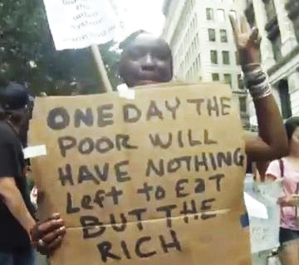
Let’s Invest Together for a Better Future for All
Notes:
Leave you with some FOOD FOR THOUGHT ---------------- THANK YOU

Slide 20
“The time for Africa to break its dependence on foreign imports is now. The local manufacture of pharmaceuticals in Africa is an opportunity to develop a broader manufacturing and knowledge based economy”
Michel Sidibe UNAIDS Executive Director 7th AUC Conference of Ministers Abuja Nigeria 25-30 November 2014
Thank You
16
20

Slide 21

Back-Up slides
16
21

Slide 22
Agenda
I
Medicine miracles in Ghana and Bangladesh?
II
Why support local manufacturing in the EAC?
III
The pharmaceutical sector in the EAC
IV
The EAC Pharma Policy Incentive Package
V
Conclusion
VI
FEAPM seeks EAC support & advise
1
22

Slide 23

Does WTO allow for this?
Price Preferences
Yes, Partner States are not bound by any WTO trade legislation
Need to be applied in a unified way throughout EAC Common Market.
Tax Incentives
Yes, need for implementation in the EAC Common Market through CET.
Import Classification
Yes, according to infant industry clause
Adequate capacities for local production for more than 60 products already exist.
Source: FEAPM Policy Paper - A look at international trade law and existing best practices
13
23
Notes:
Here, check with WTO law and already existing practices.
Price Preferences: As written in the background paper, they exist in all countries. Yet, we need to make sure that this procurement is handled on a regional market level and preferences are non-discriminating to other EAC producers. You may want to point to Procurement article 38 in the Common market protocol: Though, we are not quite sure if it perfectly applies.
Tax incentives: Here, the main problem is application of the incentives. Tax-free input lists should be made more comprehensive and tax returns administered faster.
Import classification: Often politicians think they cannot do that under WTO law, but it is allowed. Also you have to underline the fact that ample capacities exist for local production and name some examples maybe. Point to list of medicines for which capacity exist.

