Slide 1
Support for Pharmacovigilance Systems in the East African Community
By Ndinda Kusu-BPharm, MSc, MPH
Pharmaceutical Sector Investment Workshop in East African Community (EAC))
1-4 November Nairobi, Kenya

Slide 2
Overview and Perspective of SIAPS
PRESENTATION OUTLINE
Program Name: Systems for Improved Access to Pharmaceuticals and Services (SIAPS) Program
Funded by USAID and implemented by Management Sciences for Health (MSH)
Overview of the USAID/SIAPS Program
SIAPS Perspective on AMRH
Support to AMRH and the RCOREs initiative
Support to EAC-MRH Pharmacovigilance agenda
Kenya Case Study

Slide 3
Overview: SIAPS Overall Goal and
Objective
Health Outcomes
Services
Products
Goal
  To assure the availability of quality pharmaceutical products and effective pharmaceutical services to achieve desired health outcomes
Objective
  To promote and use a systems-strengthening approach consistent with the Global Health Initiative that will result in positive and sustainable health impact

Slide 4
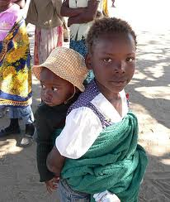
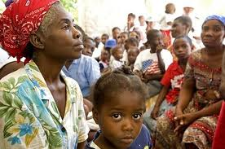
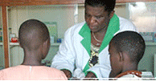
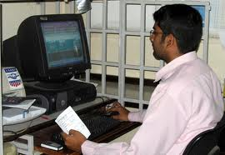

Improved Access. Improved Services.
Better Health Outcomes.

Slide 5
SIAPS Partners and Specialized Resources
Accreditation Council for Pharmacy Education
Harvard University
Logistics Management Institute
University of Washington’s Department of Global Health
Pilgrim Institute
School of Public Health
African Medical and Research Foundation
Ecumenical Pharmaceutical Network
Results for Development
Imperial Health Sciences
VillageReach
William Davidson Institute
Notes:
MSH (Lead)
Saving lives and improving health, especially among the world’s poorest and most vulnerable people, by closing the gap between knowledge and action in public health. As a result of our work, leaders, health managers, and communities in developing nations are increasingly able to tackle complex public health challenges. Since 1971, MSH has worked with its partners in more than 140 countries to improve health services. We’ve helped public and private organizations throughout the world to effectively manage people, medicines, money, and information. Clients include ministries of health and nongovernmental, faith-based, and civil-society organizations that manage and deliver health services in developing countries.
Partners:
Accreditation Council for Pharmacy Education
Accreditation of pharmacy education and training; development and evaluation of quality standards for pharmacy degree programs and continuing education providers in the United States and abroad; training of evaluators to provide standardization and consistency in the accreditation review process
Harvard University
Pharmaceutical health insurance, treatment adherence, and pricing information/mechanisms; applied and operations research and evaluation of programs and policies; cost-effective analysis of different interventions; and policy and program activities in logistics systems and pharmaceuticals; SIAPS will be working with two institutes at Harvard –
Harvard Pilgrim Health Care Institute
Harvard School of Public Health
Logistics Management Institute
Pharmaceutical supply chain and logistics management in support of global health initiatives; acquisition management; and financial management expertise to conduct policy option analyses on contracting for pharmaceutical-related services.
University of Washington’s Department of Global Health
Pharmacoepidemiology, pharmaceutical care services, pharmacovigilance, pharmacoeconomics, and product quality control and assurance
Specialized Resources
African Medical and Research Foundation
Strengthening laboratories as an integrated part of strengthening health systems
Ecumenical Pharmaceutical Network
Liaison to mission sector in developing countries, coordination and networking, development and provision of technical assistance on pharmaceutical policy and services, human capacity development, and consumer/patient education related to pharmaceutical management and medicines use
Results for Development
Research and evaluation; leadership development to advance policy and strengthen health systems; health financing and demand-side models such as health insurance; strengthening the capacity of civil society organizations; and integration and collaboration of the public and private sectors to better achieve national health goals
RTT Group
South Africa-based warehousing and distribution service support
VillageReach
Management information systems in a developing country context, particularly mHealth and open-source solutions; reaching the last mile of the supply chain; offices in Malawi and Mozambique
William Davidson Institute
Operations research, supply chain management in developing countries, investigation of business-based approaches to improving health care delivery, research to advance the transition from donor dependence to market-based health systems

Slide 6
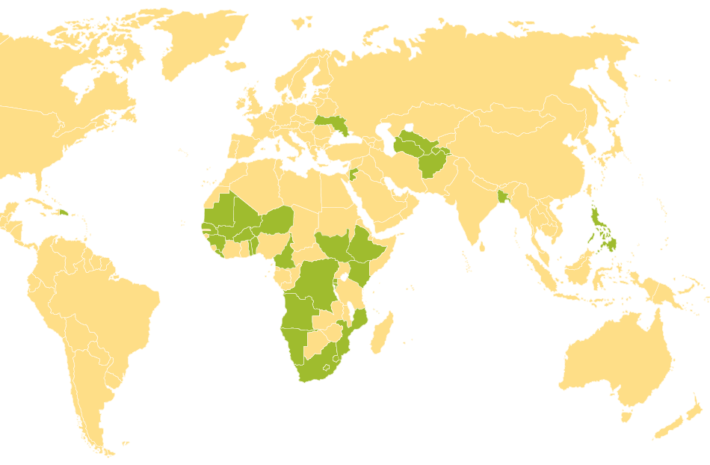
Where We Work
Angola
Bangladesh
Burundi
Cameroon
Dominican Republic*
DRC
Ethiopia
Lesotho
Guinea
Mali
Mozambique
Namibia
Niger
Philippines
South Africa
South Sudan
Swaziland
Ukraine
Uzbekistan*
West Africa Region
LAC Region
SPS - AA
Afghanistan
Kenya
TA in ≈ 30 countries
Offices in 20 countries
≈ 300 Staff worldwide
≈ 80% of staff from host country

Slide 7
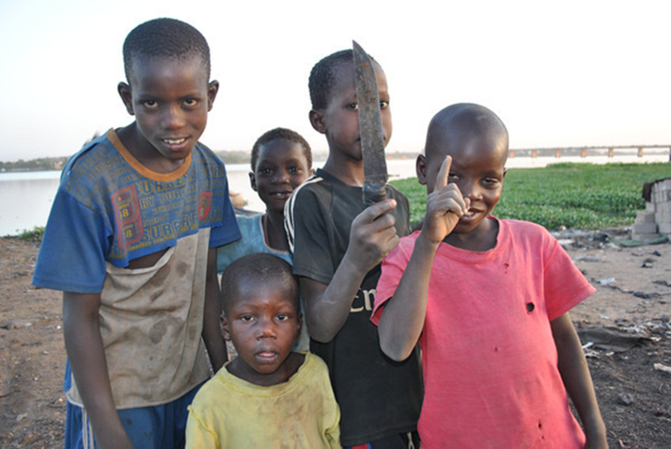
SIAPS Perspective on AMRH
Overall aim of AMRH
  Support African countries to improve public health by increasing access to good quality, safe and effective medicines through harmonizing medicines regulations, and expediting registration of essential medicines
Goal of SIAPS
  To assure the availability of quality pharmaceutical products and effective pharmaceutical services to achieve desired health outcomes

Slide 8
USAID/SIAPS Contributions to AMRH
Member of AMRH Technical Working Group on Regulatory Capacity Development (TWG-RCD)
Contributed Technically to the development of the “Model Law” on Medical Products Regulation
Specific support to Pharmacovigilance (PV) RCORES
  Kenya’s Pharmacy and Poisons Board
  WHO Collaborating Center, Accra
Support RCOREs members to participate publish and attend international and regional forums
Provides TA to develop country specific actionable Regulatory and Pharmacovigilance (PV) priorities in some countries
Focus on expanded partnership with international/local organizations and specialized academic institutions

Slide 9
Support to EAC Pharmacovigilance Agenda under EAC-MRH Initiative (1)
  Under EAC-MRH agenda, USAID/SIAPS is focusing on strengthening Pharmacovigilance systems
    Anchored on joint activity plan and formal MOU and with EAC
  All activities are coordinated by the EAC secretariat
USAID/SIAPS contributed to the development of the proposal on “Harmonization and Strengthening Pharmacovigilance Systems for Medicines, Health Products and Health Technologies.”
  USAID/SIAPS provided Financial and Technical Support for selected activities working with EAC-Pharmacovigilance EWG, WHO and other AMRH partners.
In collaboration with EAC and World Bank, USAID/SIAPS supported Kenya Parliamentary Health Committee workshop in April 2016:
  domestication and advocacy for implementation of East African Community health laws and regulations in the Republic of Kenya

Slide 10
Support to EAC Pharmacovigilance Agenda under EAC-MRH Initiative (2)
  USAID/SIAPS supported the EAC secretariat and PV/PMS Expert Working group to develop harmonized Pharmacovigilance indicators and assessment tools ( 2015/16)
    Collaboration with WHO and AMRH partners.
  Adapted from the WHO Pharmacovigilance Indicators and Strengthening Pharmaceutical Systems/ Indicator- based Pharmacovigilance Assessment Tool (IPAT).
  Plans to pilot test and validate the assessment tools as part of a baseline assessment of PV systems in EAC partner states (Jan-March 2017)
  USAID/SIAPS contributed to development of the EAC multi-project proposal on strengthening pharmaceutical sector-July 2016
    Focused on the Pharmacovigilance component

Slide 11
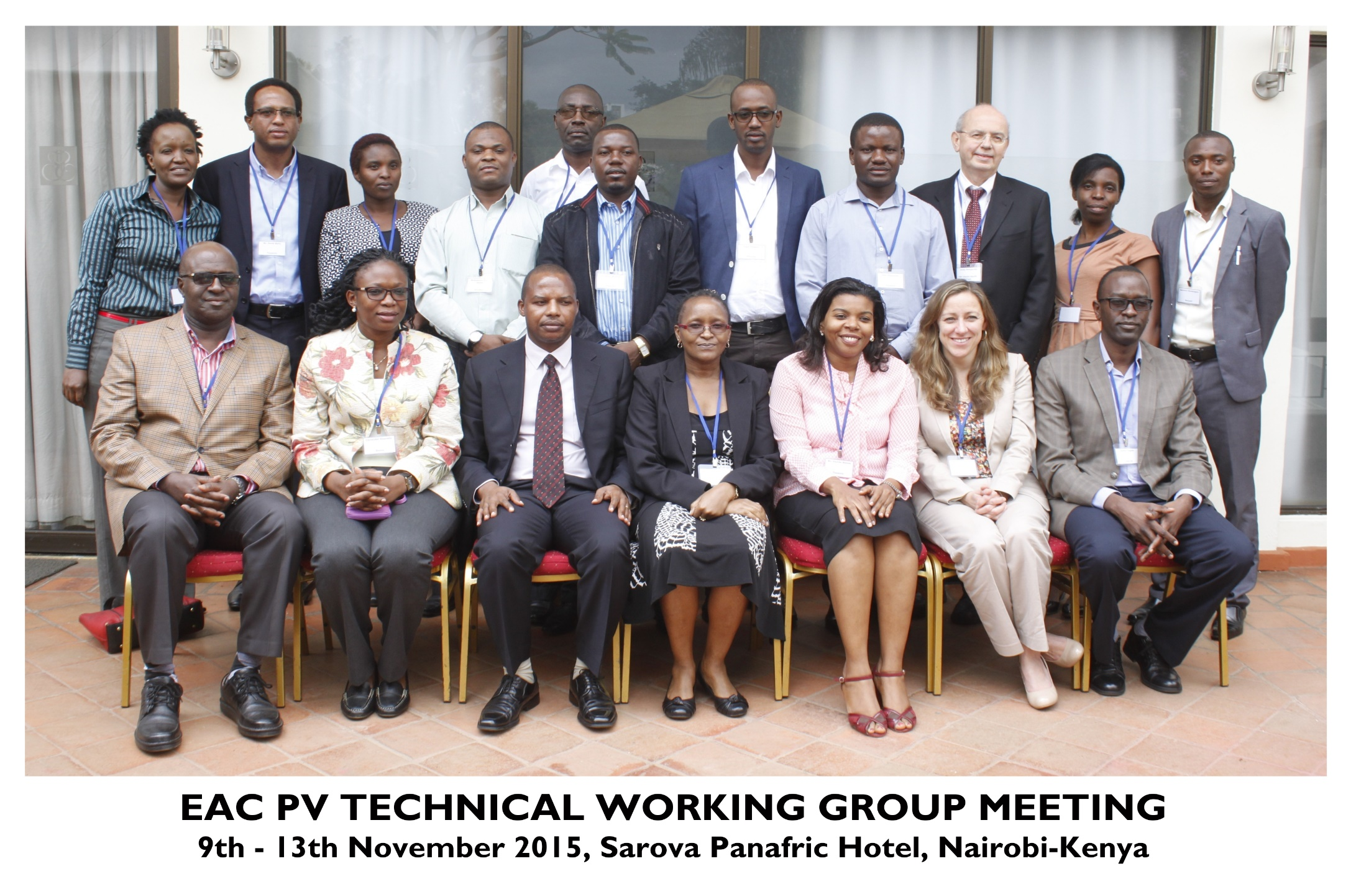
Support to EAC-PV Expert Working Group

Slide 12
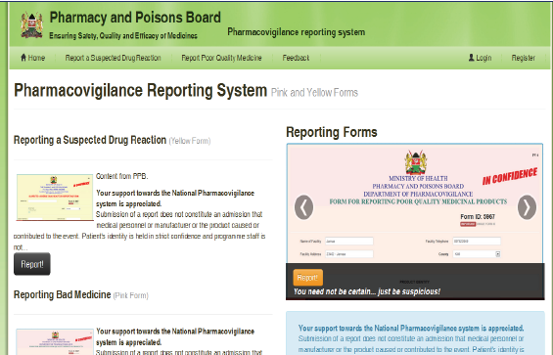
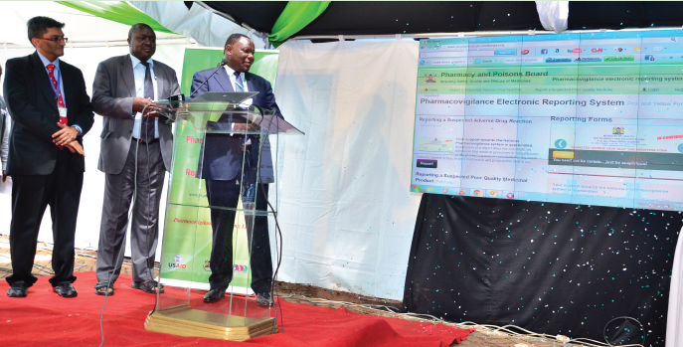
KENYA: MSH/HCSM Support to Pharmacovigilance & Patient safety Initiatives
  Supported the Pharmacy and Poisons Board (PPB) to implement “one national” and integrated Pharmacovigilance system:
Developed PV guidelines, job aids and training packages
Developed and rolled-out the PV electronic reporting system (PVERS)
Improved Pharmacovigilance data acquisition, management, use and feedback
  Capacity-building on PV; provision of tools
  Enhanced reporting & utilization of PV data for decision-making → Lifesaver newsletter and PV summary reports
Jointly with PHPs and PPB, supported PMS for ARVs, anti-TBs, antibiotics etc
Implemented the HIV Cohort Event Monitoring (CEM) system in collaboration with NASCOP → Developed the CEM data management system
Government Officials at the PV ERS launch April 2013

Slide 13
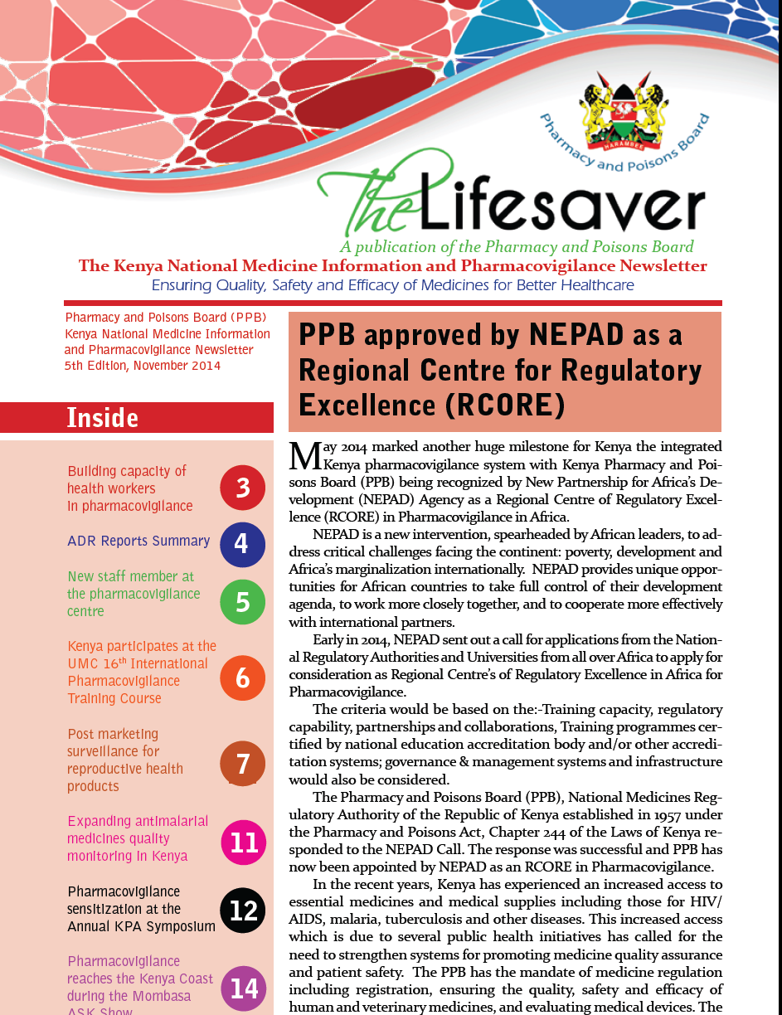
MSH/HCSM Support to Pharmacovigilance in Kenya: The So-What?
  The innovative digital system made reporting easier, cost effective, and prompt, and is being adopted for the EAC region and other countries
  Jointly with USAID/SIAPS, University of Washington and University of Nairobi, developed and institutionalized MSc in Pharmacoepidemiology and Pharmacovigilance
  Kenya recognized as a Regional Centre of Regulatory Excellence in PV. Other countries learning from Kenya on PV system rollout.
Improved reporting of PV information to PPB has resulted in─
quarantining, recalling, or withdrawing some medicines; changes in labeling; line inspections for continuous GMP etc
Review of ART guidelines in 2011, 2016

Slide 14
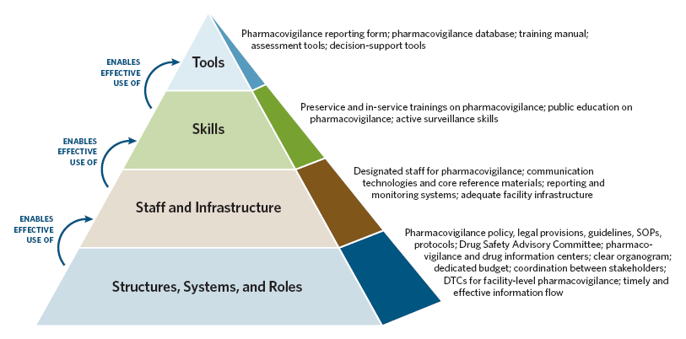
USAID/SIAPS-Systems and Capacity Building Approach
Adapted from: Potter, C., and R. Brough. 2004. Systemic capacity building: A hierarchy of needs. Health Policy and Planning 19:336–45.

Slide 15

The Tao (Way) of Leadership
GO TO THE PEOPLE
LIVE AMONG THEM
LEARN FROM THEM
LOVE THEM
START WITH WHAT THEY KNOW
BUILD ON WHAT THEY HAVE
BUT FOR THE BEST LEADERS
WHEN THEIR WORK IS ACCOMPLISHED
THEIR WORK IS DONE,
THE PEOPLE WILL REMARK
WE HAVE DONE IT OURSELVES

Slide 16


