Slide 1
Pharmacovigilance at GSK
Presented by:
Dr. Robert Miano
Medical Affairs Executive and Named Safety Contact, Kenya and East Africa

Slide 2

OUR GLOBAL NARRATIVE

Slide 3
Brief introduction to pharmacovigilance
Pharmacovigilance: Science and activities related to the detection, assessment, understanding, response and prevention of adverse drug reactions (ADRs) and other potential medicine-related problems –
Including adverse events following immunization (AEFI): Vaccine Pharmacovigilance
Specific aims of Pharmacovigilance
Improve patient care and safety for medical and paramedical interventions.
Improve public health and safety for all medicines.
Assess benefit, harm, effectiveness and risk of medicines.
Encourage safe, rational and (cost-)effective use of medicines.
Promote understanding, education and clinical training in PV.
Effectively communicate surveillance results to the public.

Slide 4
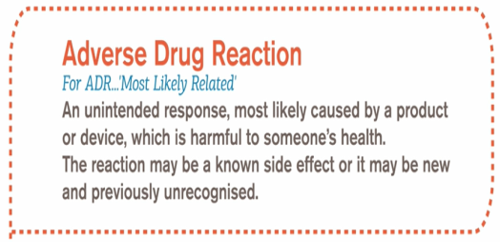

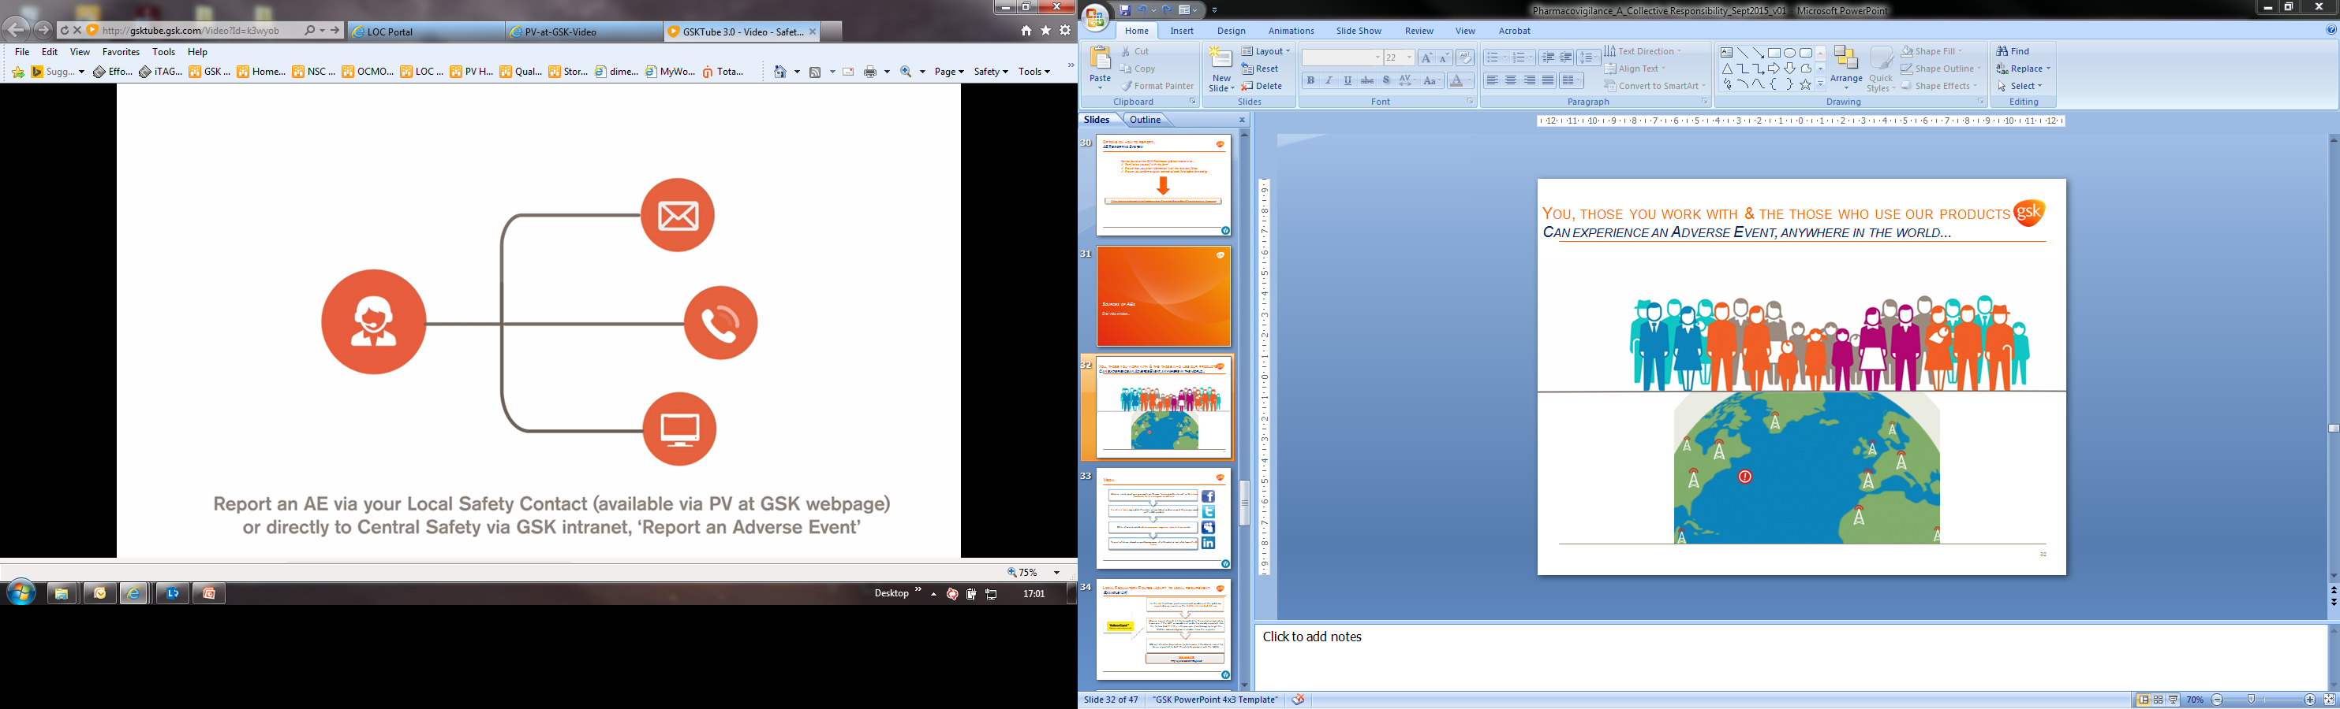
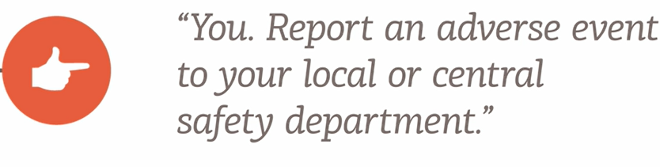
NOTE: Even if you are not sure whether a product has caused an adverse event, you MUST report it
Who is responsible for reporting Aes AT GSK?
How to report an AE...
All GSK employees, complementary workers, third parties & vendors working on behalf of GSK must report any human safety information, including AE’s, involving any GSK Product, to the relevant Central Safety Department OR local operating company medical department within 24 hours of initial awareness.
Write
Call
Email

Slide 5
The need for pharmacovigilance in Low and Medium Income Countries
Drugs and vaccines are reaching unprecedented numbers of people.
  Some vaccines and medicines developed specifically for underserved areas of the world
  advancing into pre/post licensure stages
  e.g. RTS,S/AS01 malaria vaccine candidate (African focused)
  Chlorhexidine gel: prophylaxis for omphalitis in new borns
  Regions with suboptimal PV infrastructures
  Specificities of underlying comorbidities
  HIV, malnutrition........
  Safety profile might be different
Notes:
Although many drugs have been used and studied in developed countries, their safety profiles may not necessarily be applicable to other settings, where the incidence, pattern, and severity of ADRs may differ because of local environmental and genetic influences.
Developing country regulators will not be able to rely on the safety and benefit-risk assessments conducted in developed countries for these drugs and vaccines since most will be launched exclusively or simultaneously in Low and Middle-Income countries (LMICs).
New manufacturers with exclusive focus on supply to LMICs

Slide 6
The Challenges in LMICs
Low reporting of adverse events
  Incompletely filled AE forms
  Delayed transmission of AE forms
Lack of human resources
  No dedicated personnel
  Inadequately trained and sensitized health care workers (HCWs)
  No expertise for causality assessment
Communication gaps to HCWs and the public
  Misperception of risks and rumors
Lack of funding for PV
Increased Informal and traditional health sector
Notes:
Health problems are operated in challenging conditions but still providing high impact. However, there are indeed a number of challenges for safety monitoring in LMICs.

Slide 7
Assessments of pv Capacity in sub saharan africa
Minimal capacity for pharmacovigilance
There are no legal or structural frameworks for PV systems and no coordinated passive or active surveillance in these countries
Majority of SSA countries- Democratic Republic of Congo, Cameroon, Burkina Faso.
Basic capacity for pharmacovigilance
Legal framework, PV policy, safety advisory committee
Senegal, Malawi, Mozambique
PV activities (e.g., collecting ADR data in a few hospitals or programs) take place without national coordination.
Limited capacity to generate signals and evaluate the risks without functioning spontaneous reporting programs
Ref: Strengthening Pharmaceutical Systems (SPS) Program. 2011. Safety of Medicines in Sub-Saharan Africa: Assessment of Pharmacovigilance Systems and their Performance. Submitted to the US Agency for International Development by the Strengthening Pharmaceutical Systems (SPS) Program. Arlington, VA: Management Sciences for Health.
A Report to the Safety and Surveillance Working Group, Bill & Melinda Gates Foundation, 2014
Notes:
Even though PV has seen tremendous growth over the past 10 years in developing countries, these countries are still not adequately equipped to address medicine safety issues.

Slide 8
Assessments of pv Capacity in sub saharan africa
Capacity to collect and evaluate safety data
Organizational structure and policy framework to collect safety data, collate them in a national database, and evaluate the risks and benefits by both passive and active approaches
Tanzania, Ghana, Kenya
Adequate performing Pharmacovigilance systems
Detect, evaluate, and prevent medicine safety issues. These countries have the capacity for passive and active surveillance activities, and risk evaluation
South Africa, Namibia, Nigeria, and Uganda
Ref: Strengthening Pharmaceutical Systems (SPS) Program. 2011. Safety of Medicines in Sub-Saharan Africa: Assessment of Pharmacovigilance Systems and their Performance. Submitted to the US Agency for International Development by the Strengthening Pharmaceutical Systems (SPS) Program. Arlington, VA: Management Sciences for Health.
A Report to the Safety and Surveillance Working Group, Bill & Melinda Gates Foundation, 2014
Notes:
Even though PV has seen tremendous growth over the past 10 years in developing countries, these countries are still not adequately equipped to address medicine safety issues.

Slide 9
Proposal: Enhanced PV sentinel surveillance capacity building pilot project for SSA

Slide 10
Enhanced PV Sentinel Surveillance
Capacity Building Pilot Project
Enhanced SENTINEL site surveillance
  Enhance spontaneous reporting
    Dedicated site nurse in 1 health care facility.
    Improve AEFI/ADR detection and reporting
  PV trainings and mentoring of HCWs
  Feasibility of Electronic transmission of AEs
  Routine Communication
  Performance evaluation
  Pilot project: I year + 6 months extension

Slide 11
Enhanced PV Sentinel Surveillance
Capacity Building Pilot Project
Collaboration Proposal
  MOH led initiative
    National vaccine technical stakeholders
    Country ownership
    Long term sustainability
  Technical support from GSK and PATH.
    PV training
      Kick off meeting and every 6 weeks
      HCWs in sentinel site + districts
    Mentorship
      Every 6 weeks
      All trained HCWs
  Financial support from GSK for 2016 and 2017.
    Dedicated site nurse and data manager

Slide 12
HARMONIZATION OF PV REGULATIONS
In many parts of the world, regional networks have been created to support harmonization and regulatory convergence, including PV. Some of them have developed regional guidance documents to assist countries in adapting global best practice guidelines to the local context-See ref.
Currently national PV guidelines in the region differ in content requirement and periodicity.
Divergent guidelines present a challenge to MAHs in terms of resource requirement and capacity for hundreds of products at different frequencies for different markets.
EAC harmonization efforts for PV guidelines will be pivotal in simplifying reporting across the region with the additional benefit of PV capacity synergy for NRAs.
( Ref: Pharmacovigilance in resource-limited countries; article in Expert review of clinical Pharmacovigilance, June 2015. )

Slide 13
CONCLUSION
Regulators, industry players and development partners collaboration in PV capacity enhancement for LMICs is commendable.
Greater public awareness is required to improve quality of AE reporting.
Additional budgetary support required to enhance capacity-Human and technological.
Greater surveillance and research initiatives will improve understanding of state of safety.
Strong support required for harmonization of PV guidelines across the region.
Notes:
Include mention of harmonization effort for code of practice alongside GMP and registration

