Slide 1

EAC Initiative to support health Research and Development
1st International Conference on Promoting Pharmaceutical Sector Investments in the EAC Region
Prof Gibson Kibiki; MD, MMed, PhD
Executive Secretary
East African Health Research Commission
East African Community
gkibiki@eachq.org

Slide 2
EAHRC: regional initiative in Health R&D
PROTOCOL ON THE ESTABLISHMENT
  By Heads of EAC States on 13th Sept 2008
    Signed the Protocol for establishment of the East African Health Research Commission (EAHRC)
  As per provisions of the article 118 of the Treaty of the EAC
  In May 2015, the EAHRC secretariat officiated
OBJECTIVE OF THE PROTOCOL
  EAHRC has been established as a mechanism for making available to the EA community, advice upon all matters of health and health- related research and findings that are necessary for
    Knowledge generation
    Technological development
    Policy formulation
    Practice
    And for other related matters
  EAHRC is the principal advisory institution to the EAC on health R&D

Slide 3
Research programmes and networks
Coordinate, promote, facilitate
Development of collaborative Research programmes in the region
Development of network of health research institutions
Development of Centres of Excellence in health research
Mechanisms for collaboration in health research in the Partner States
Establishment of TWG for priority health research and policy areas
Establishment of National Focal Points
Establishment of national/international research stakeholders
Audit research projects and programmes in the region

Slide 4
Research capacity building
Develop human resource capacity and skills in health research
Facilitate the development of collaborative research capacity building programmes
Assist the governments of the Partner States and health research institutions to identify the best ways of developing and retaining qualified health research personnel
Assist in strategic planning in health research institutions and other organisations performing health research
Assist member institutions identify and implement good practices in management of health research projects and appropriate use of resource
Assist Governments and other bodies in the development of strategies for adequate investment in health research in the region
Play critical roles in search for research resources and grants

Slide 5
Improvement of research environment
Facilitate joint ethics clearance of research protocol and proposals in the region
Help member institutions identify and implement good practices in the conduct of research
Play the EAC liaison role with national, regional and international health institutions and other collaborating organizations
Develop quality control and quality assurance process in order to achieve and maintain international standards in health research in the region
Provide regulatory guidelines and standardization of research protocols and proposals
Assist in the establishment of quality assurance through
  Facilitation, in partnership with regulatory authorities within the Partner States regarding conduct of ethical health research
  Development of, in partnership with the national regulatory authorities, criteria for assessing standards and assuring the quality of health research in the region
Address common intellectual property rights issues of relevance to health in the partner states
Use resources availed by the Partner States to implement the Commission’s functions

Slide 6
Health Research knowledge management
Promote the application of knowledge from research to strengthen regional health policy formulation and practice
Facilitate the development of regional health policies and their implementation
Promote the exchange of, and dissemination of health research information through conferences, workshops, publications, web portal, etc.
Facilitate the creation of the of health research database to strengthen health policy and practice
Promote Community outreach activities in implementation of the research findings
Establish and maintain harmonised network of morbidity and mortality registries for all diseases, illnesses and conditions which may occur at community, health facility, district, national, and regional levels within the Partner States

Slide 7

EAHRC
In order to fulfil its mandate, the Commission
conducts, coordinates, oversees, promotes, facilitates,
and carries out the following
EAST AFRICAN HEALTH RESEARCH COMMISSION
Research for Health and Prosperity
As per provisions of Article 118 of the Treaty of Establishment of the EAC

Slide 8
Strategic objectives of the EAHRC Strategic Plan
 | Strategic Focal Areas | Strategic Objectives
1 | Institutional Capacity Development | To establish institutional governance, management, and operational framework.
2 | Resource Mobilisation | To mobilize resources to support health research for development.
3 | Research Collaboration and Capacity Development | To establish research and capacity strengthening programmes, networks, partnerships and Centers of Excellence, and harness advancement in science, technology and innovation (STI), and information and communication technology (ICT).
4 | Research Environment | To create an environment conducive for research and harmonized regional regulatory and ethics review frameworks.
5 | Knowledge Management | To establish mechanisms for generating, capturing, synthesizing, assessing, sharing, disseminating and utilizing knowledge for solving the health challenges and support the development aspirations of the Community.
6 | One - Health Approach | To promote One-Health Approach and integrated research involving animal health, human health and the environment.

Slide 9
EAHRC ORGANOGRAM
Executive Secretary
Deputy Executive Secretary – Research
Research, Innovation, & Development
Research Capacity Development
Deputy Executive Secretary – Finance & Administration
Ethics, Regulatory Affairs, and Research Environment
Human Resource, Administration & Finance
TWGs/EWGs
NFPs
NSHs
Dev Partners
PS
Legal Affairs
Procurement
Internal Audit
Planning & Development
Resource Mobilization
Public Relations Office
Knowledge Management
Notes:
Commissioners, EAC structure

Slide 10
EAHRC PROGRAMMES relevant to the EA Pharm Industry
  EA Clinical Trials Network (EA TWENDE CTN)
      Critical mass (infrastructure, tech, human resource) for Clinical trials in Drugs, Devices, vaccine,
      A fully fledged capacity development in clinical trials
      Support the EAC Pharmaceutical industry in EA; e.g. Bioanalytical studies; Bio-equivalency, pharmacogenetics, etc.
        FEAPM (Federation of the EA Pharmaceutical Manufacturers)
  KM Platforms
    Journal: The East African Health Research Journal x3/year. 1st issue Jan – March 2017
    EA Health and Scientific Conference and International Health Exhibition and Trade Fair
      29th – 31st March 2017, Bujumbura, Rep Burundi
    EA Web portal: a comprehensive compendium of health information
      EA Pharm industry visible globally
      EA Open Science Cloud for Health Network
3. REACH – PI: Regional East African Community Health Policy Initiative
  Platform for Knowledge transfer linking researchers and health policy makers for evidence-informed policy and practice.
  A knowledge translation strategy to promote health
4. EA Regional Harmonisation of Ethics and Regulatory processes
  Smooth processing of ethics and regulatory requirements for research programmes in the region
  Baseline studies
Notes:
the continuous and ongoing data analyses in health systems innovation, health data science, governance and finance in the intersection of globalization, innovation and mobility. This has the overall aim to, in a sustainable manner, increase accessibility to health services, and improve the quality and effectiveness of health services.

Slide 11
KEY FACTORS

Slide 12











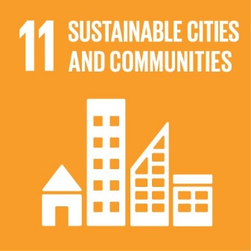






Over the next 15-years: end poverty, protect the planet, ensure prosperity for all
Notes:
On September 25th 2015, countries adopted a set of goals to end poverty, protect the planet, and ensure prosperity for all as part of a new sustainable development agenda. Each goal has specific targets to be achieved over the next 15 years.

Slide 13
Key factors unique for the millennium and major for LMICs
Globalisation
  Unlike anytime before, Globalisation will be a key feature of this millennium and have major influence to health
    Epidemiology: change in disease transmission pattern
  The paradox between opportunities and threats to health, makes Globalisation a delicate balance
Global climate change
  Until now, changes in the global climate have occurred naturally, across centuries or millennia
  Over the past few decades
    Human actions are significantly changing atmospheric composition → global climate change →pose serious health risks (drought, floods, etc.)
Most of the deadliest epidemics in the history of mankind are still prevalent, and new epidemics are incipient
  Let’s not turn back to business as usual once we are over with an epidemic crisis
    as we are likely to confront the toughest crisis in disease outbreaks once again in our lifetime
Convergence of NCDs and IDs (TDs)
  NCD are setting in a terrain which has been significantly modulated by chronic occurrence of ID and NTD
  The convergence → to specific features different from NCD alone
      HIV & DM
      TB & DM
  Research is imperative to guide treatment modalities, and thus pharm manufacturing
Antimicrobial resistance
  We are rapidly loosing the available agents due to resistance
  May head back to the pre-antimicrobial era
    Trivial ailment → death
  New approaches, new products are urgently needed
  ID are here for a long haul! Coupled by NCDs

Slide 14
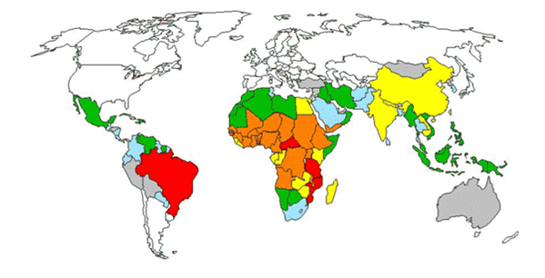
Neglected Tropical Diseases
‘our problem, our solution?’
Extent of neglect, countries with endemic distribution
of multiple neglected tropical diseases " Endemic Parasitosis“.
Between 1975 - 1999 only 13 (0.9%) drugs of 1393 new chemical entities (NCE) marketed,
were for NTD
Over the past 30 yrs: drugs for NTD are 10, or 18 (incl for Malaria), and 21 (incl for TB)
This is 1% of all the NCE (1556) launched till 2007
Our Pharm industry has a role here too
Notes:
CEPI to draw attention towards prevention of NTD e.g. vaccine development

Slide 15
Thank you
EAST AFRICAN HEALTH RESEARCH COMMISSION
Research for Health and Prosperity
gkibiki@eachq.org

