Slide 1






EAC PRIORITIZATION OF THE PHARMACEUTICAL SECTOR
By ENG. Jennifer Gache, Senior Industrial Engineer, EAC Secretariat
1 November, 2016

Slide 2
OUTLINE
Introduction
Background on EAC Industrialization Policy
Progress
Council Directives on the pharmaceutical sector

Slide 3
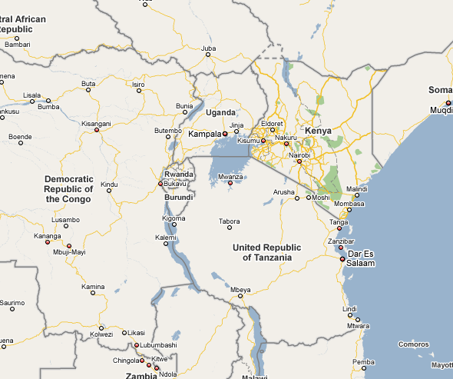
Introduction to the Region: EAC-COMESA-SADC Free Trade Area
Presents an integrated market of 26 countries;
A combined population of almost 600 million people (57% of the AU population), that is, half of the African Union (AU) in terms of membership;
Total Gross Domestic Product of about US$ 1 trillion (58% of the continent’s GDP).

Slide 4


WHY EAC INDUSTRIALIZATION ?
Low per Capita Income
Unemployment
High Demand for Social Support
EAC DEVELOPMENT VISION
Reduced interest for Local and FDI in manufacturing etc
Less Funding for Development Programs
Poor infrastructure and support for investment

Slide 5
Background on EAC Industrialization Policy
Theme: Structural Transformation of the Manufacturing Sector through High Value Addition and Diversification.
The strategy focuses on the Manufacturing sector in the region. See UN(ISIC) Codes, Rev.3.1
Based on comparative and competitive advantage.
Emphasis strategic regional value chains with long backward and forward linkages with the rest of the economy thereby increasing employment and quality of jobs
Recognizes that access to high quality education, R&D and Innovation is vital for strengthening the productivity of the labour force and accelerating growth
Market led-Private Sector Approach

Slide 6
Specific Targets of the Industrialization Strategy
Objective | Present 2011 | Target 2032
Diversifying the manufacturing base and raising local value added | Estimated value of 8.62% | To at least 40%
Manufacturing industry’s contribution to the regional GDP | Currently at an average of 9.7% | To an average of 25%
Manufacturing based employment | 456,000 | About 2.3 million
GDP per capita | $ 558 | $ 1,300
Transforming micro small and medium enterprises into viable and sustainable business | Contribution 20% | Contribute 50 % of manufacturing GDP
Increasing manufactured value added per capita | $ 50 | $ 258
Strengthens Institutional capabilities to deliver support services
Strengthen Research, Development Technology and Innovation

Slide 7
Background: EAC industrialization policy and strategy identifies sectors to be developed to achieve a number of regional policy goals
Local Value Addition (40 %)
SMEs-50% GDP Contribution
Increase employment opportunities to 2.3 million
Increasing manufacturing share of GDP to 25 %
Trade expansion- 60% exports & 25% intra-EAC trade

Slide 8
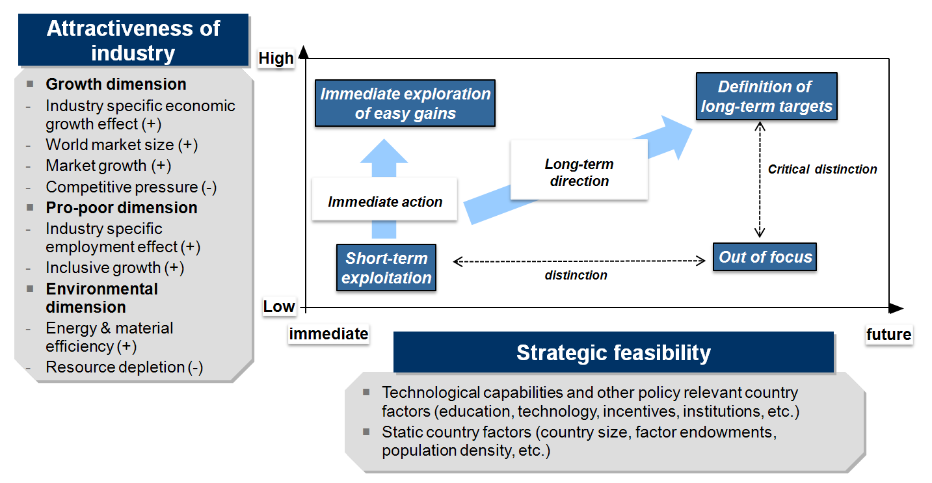
Short-listing of Regional Industries – Assessment Framework
Source: UNIDO; 2011

Slide 9
Industries with High Growth Potential in the Region based on Assessment Framework

Slide 10
Attractiveness and Strategic Feasibility of a Targeted Industry (Using an Assessment Framework)
Six strategic Industries prioritised:
    Agro-processing
    Fertilisers and agrochemicals
    Pharmaceuticals;
    Petro-chemicals and gas
    Iron-ore and other mineral processing;
    Energy and bio-fuels.

Slide 11
Progress
The EAC Industrialization Policy and Strategy was approved in November 2011.
The Action Plan for the Implementation of the EAC Industrialization Policy and Strategy was approved by the Sectoral Council on Trade, Industry, Finance and Investment (SCTIFI), during its meeting held on 2nd November 2012.
EAC Regional Pharmaceutical Manufacturing Plan of Action (EAC-RPMPOA), 2012-2016 was approved in 2011;
Implementation of EACRPMPOA is part of implementation of the EAC Industrialization Policy and Strategy

Slide 12
Council Directives on Implementation of EACRPMPOA-Health
The Sectoral Council of Health in a meeting held on 17th April 2014(Report Ref. EAC/SR 167/2013) in Zanzibar, United Republic of Tanzania (URT):
  approved the Terms of Reference for establishment of a regional steering committee and
  directed the Secretariat to establish a joint working group between the Health and Industry to address the issue of development of the pharmaceutical industry in the region. The joint working group has been established at a regional level.
  Noted that implementation of the plan will be coordinated by the department responsible for industrialization.

Slide 13
Council Directives on Implementation of EACRPMPOA-Industry
The Sectorial Committee on Industrialization in the meeting held on 20th to 22nd August 2014 (Report Ref. EAC/SCI/002/2014):
called on the establishment of national steering committees comprising the industry and health sectors to fast track the implementation of the Plan of Action.
The meeting agreed that the responsibility of coordinating the implementation would be spearheaded by the Ministry responsible for Industrialization who would establish a Focal Point for implementation of the Action Plan and a Champion to drive the process.

Slide 14
Sectoral Council on Trade, Industry, Finance and Investment (May 2016)directives on the sector called for:
(i) Meetings between health and industry to coordinate implementation of the Action Plan and also address issues of the development of Pharmaceutical Industry in the Region particularly enhancement of local production of medicines ;
(ii) Review of EAC Pharmaceutical Manufacturing Plan of Action);
(iii) Support to EACRPMPOA National Coordination Committees in Partner States to prepare Action Plans;
(iv) Continued support to the development of Trade Related Aspects of Intellectual Property Rights (TRIPS) policy on the use of public health related TRIPS flexibilities;
(v) Trainings and Sensitization on domestication of the TRIPS Policy; done in-conjunction with UNCTAD; WTO; WIPO and WHO; and
(vi) Support to promotion of a policy brief on an Incentive Framework for the promoting local manufacturing in corporation with the Federation of East African Pharmaceutical Manufacturers‘ (FEAPM);

Slide 15
Sectoral Council on Trade, Industry, Finance and Investment directives on the sector:
Noted that Kenya is already in the process of implementing a Good Manufacturing Practice (GMP) road map and that the initiative is also being undertaken at the continental level spearheaded by the African Union; thus need for a regional programme;
Approved the Concept Noted on GMP Roadmap, recognized the requirement of financial resources to undertake the GMP exercise as the exercise is expensive and time consuming; and noted the; need to look into public private arrangements in implementing the road map ;
Noted that the EAC had adopted guidelines on GMP regulations prepared by the Medicines Regulation Harmonization project and there was need to support the industry to comply with this standards;
Noted need for increasing local production of safe, efficacious and quality medicines as a priority for the region and need to include this in the terms of reference for the new EACRPMPOA; It was also proposed that programmes should be focused on enabling the manufacturers to increase production; in compliance with GPM regulations; standards and quality assurance; other programmes could focus on branding, pricing and tripartite arrangements bringing together doctors, manufactures and chemists

Slide 16
Thank you
Jennifer Gache, Senior Industrial Engineer, (gache@eachq.org)

