Slide 2
Capacity building on GMP to promote domestic pharmaceutical manufacturing
Gabriel K. Kaddu
Senior GMP Specialist
Promoting the Quality of Medicines Program
U.S. Pharmacopeial Convention
Notes:
Suggest a more concise title - example on this slide. I do not think it is necessary to specify "Overview"
General notes on presentation –
since PQM is prominent on every slide, it is not necessary to repeat it over-often in the body of the slide text or headings.
I realize the (a) this is not a training and (b) this is needed right away, so I offer the following for the next revision:
There are some very densely packed slides. I would recommend cutting down the verbiage per slide to have only the minimal major points, so that the focus of the audience will be on the strength of your presentation of the information. Otherwise, people are going to be reading while you’re speaking, and they will miss the full impact of your message.
The graphics need work. At a minimum, they should have the same color scheme. Some are slightly distorted and/or of lower resolution than optimal.

Slide 3
Outline
EAC Pharmaceutical manufacturing plan of Action
Introduction to the Promoting the Quality of Medicines (PQM) Program
Global medicines quality-assurance and WHO prequalification process
Overview of PQM technical assistance
PQM technical assistance results and public health impact
Conclusion

Slide 4
EAC Pharmaceutical Manufacturing Plan of Action (EAC-RPMPoA ) - Goal
The overall goal of the EAC Regional Pharmaceutical Manufacturing Plan of Action (EACRPMPoA) is to ensure availability and access to affordable, high-quality and efficacious essential medicines for the treatment of priority communicable and non-communicable diseases, including HIV/AIDS, Malaria, Tuberculosis (TB), Diabetes, Cardiovascular Diseases, Chronic Respiratory Diseases and Cancers as well as various Neglected Tropical Diseases (NTDs) in the region.
The main objective is to improve the capacity of the EAC region to sustainably and competitively produce quality essential medicines for local use and export.

Slide 5
Promoting the Quality of Medicines in Developing Countries (PQM)
PQM serves as a primary mechanism to help USAID-supported countries strengthen their quality assurance (QA) and quality control (QC) systems to better ensure the quality of medicines that reach patients.
PQM provides Technical Assistance to:
Manufacturers
National Medicine Regulatory Authorities (NMRAs)
National Quality Control Laboratories (NQCLs)
Treatment failure, increased morbidity, development of drug resistance, and wasted resources: The effects of substandard and counterfeit medicines are devastating. In developing countries, where resources to combat such medicines are limited, their impact is hardest felt.

Slide 6
Background
Since 1992, USP has worked cooperatively with the United States Agency for International Development (USAID) to help developing countries address critical issues related to poor quality medicines. This partnership operated as the Drug Quality and Information (DQI) program until 2009, when, to better meet growing global needs, USAID awarded USP a five-year, $35 million cooperative agreement to establish a new, expanded program—Promoting the Quality of Medicines (PQM). In 2013, USAID extended the PQM program for five years (through September 2019), increased its funding from $35 million to $110 million, and expanded the geographical reach of the program.

Slide 7
USP–USAID Cooperative Agreements
Rational Pharmaceutical Management (RPM) Worldwide 1992–2000
RPM Russia/NIS 1993–2000
USP Drug Quality and Information Program (USP DQI) 2000–2005
DQI Extended 2005–2010
Promoting the Quality of Medicines (PQM) 2009–2014
PQM Extended
2014-2019
$10 M
$110 M
$35 M
Notes:
Changed from 000,000 to M -- from a distance the multiple zeroes can be hard to see and distracting

Slide 8
Program Objectives
Promoting the Quality of Medicines
2009-2019
Build capacity and strengthen QA/QC systems
Help increase supply of QA medicines
Combat falsified, substandard and unapproved medicines
Provide technical leadership
Notes:
Strengthening medicines quality assurance systems, e.g. national quality control labs and medicine regulatory authorities
Improving the supply of quality-assured medicines, e.g. supporting WHO prequalification, assisting select manufacturers in GMP compliance and dossier preparation
Combating substandard and counterfeit medicines, e.g. through post-marketing surveillance of medicine quality, international collaborations
Providing technical assistance and global advocacy, e.g. through field-based research (cf. Quality of Antimalarials in Sub-Saharan Africa (QAMSA) Report), technical evaluation of screening tools
Developing public product standards, e.g. pharmacopeial monographs for procurement purposes and for the analysis of medicine quality
8

Slide 9
Global Quality Assurance Mechanism for Medicines Procurement
  Countries, NGOs, partners, procurement agencies are advised to procure ONLY finished pharmaceutical products (FPPs) that meet the following standards:
  Approved by the WHO Prequalification Program (WHO PQP)
  or
  Time-limited advice by an Expert Review Panel (ERP)
  or
  Authorized by a Stringent Regulatory Authority (SRA)
Notes:
Why is this important:
So that:
Apply unified standards for assessing quality, safety and efficacy (Q, S & E)
Comprehensively evaluate the Q, S & E of medicinal products and APIs, based on information submitted by the manufacturers ….. and inspection of the corresponding manufacturing and clinical sites.

Slide 10
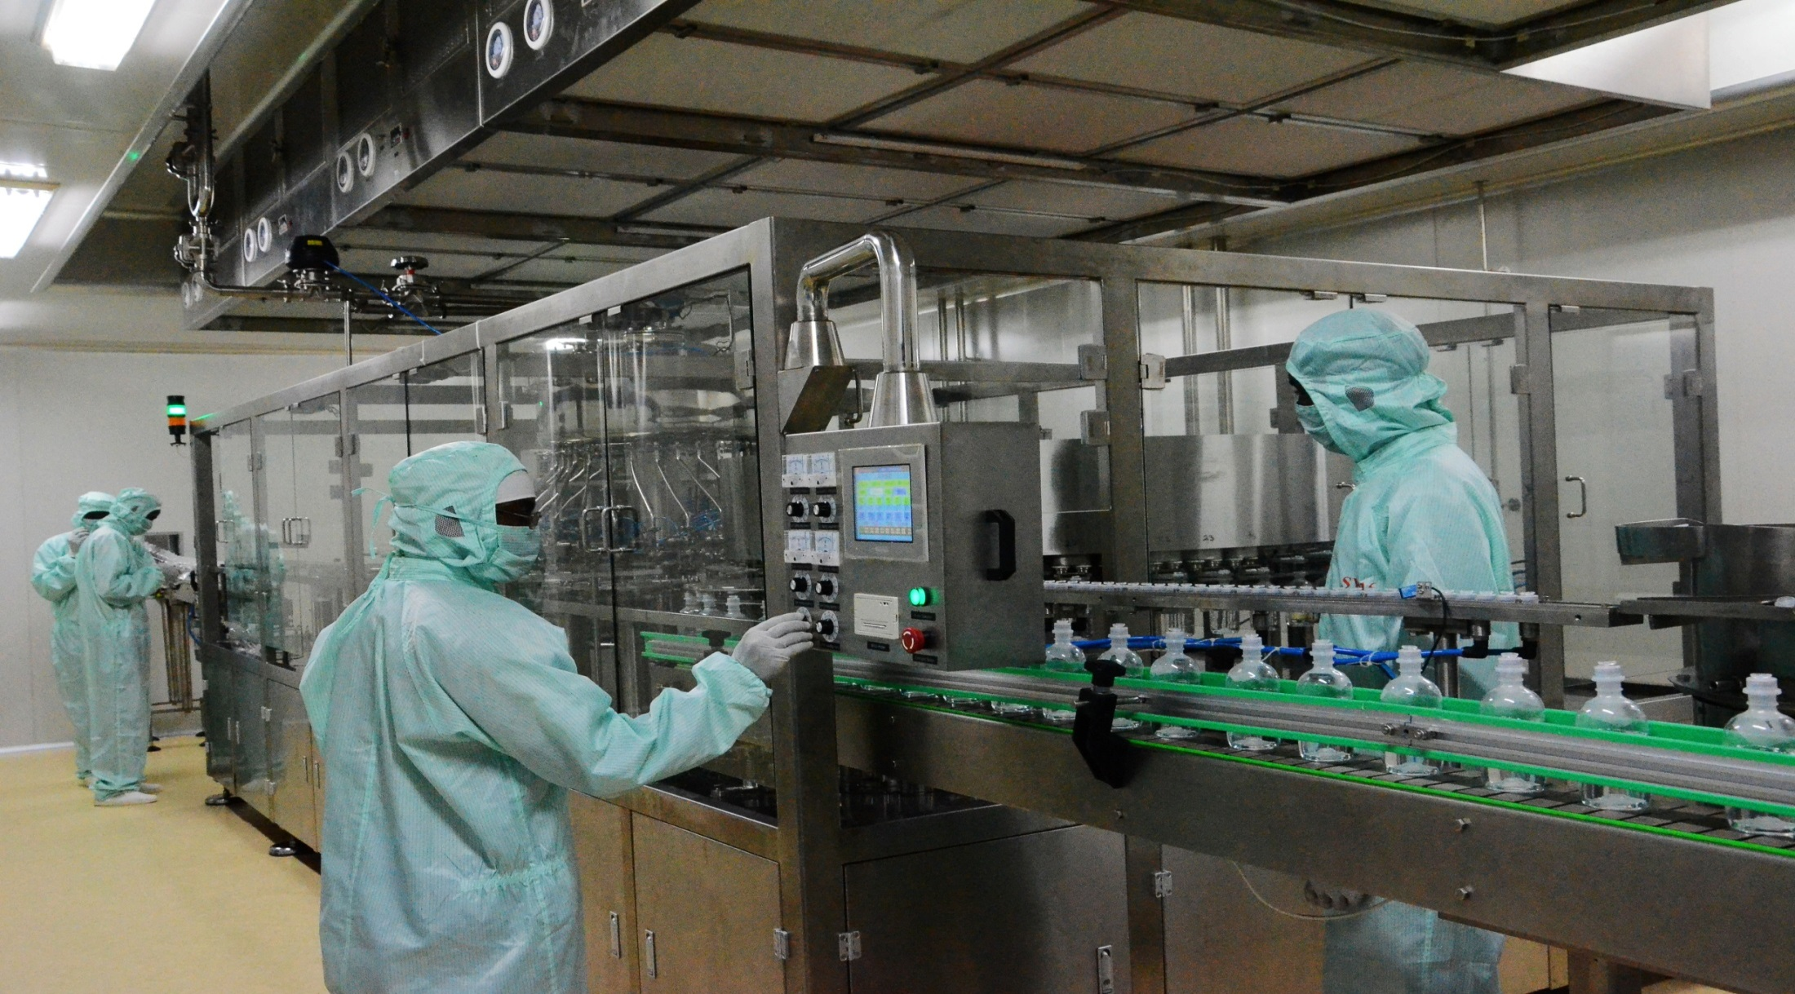
Chemistry, Manufacturing and Controls (CMCs) and Good Manufacturing Practices (GMPs)

Slide 11
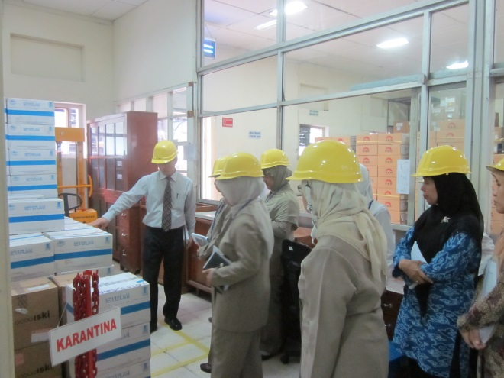
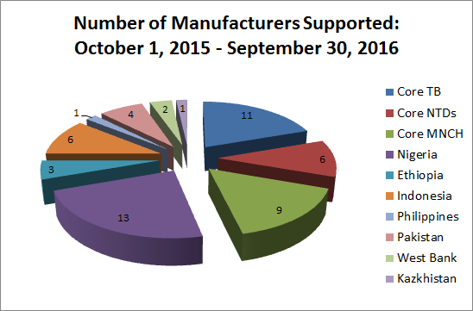
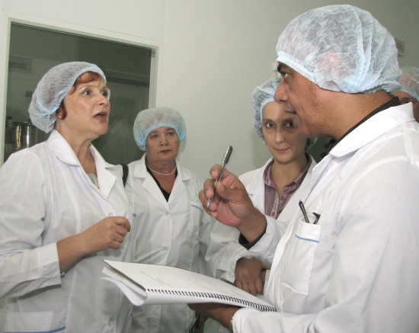
Technical Assistance to Manufacturers
Top-notch GMP experts with EU, US FDA, and WHO PQ experiences
Extensive knowledge of the API and FPP landscape of the global public health market
Strong relationship with manufacturers and CROs
Intense hands-on and results-driven technical assistance, until product is approved

Slide 12
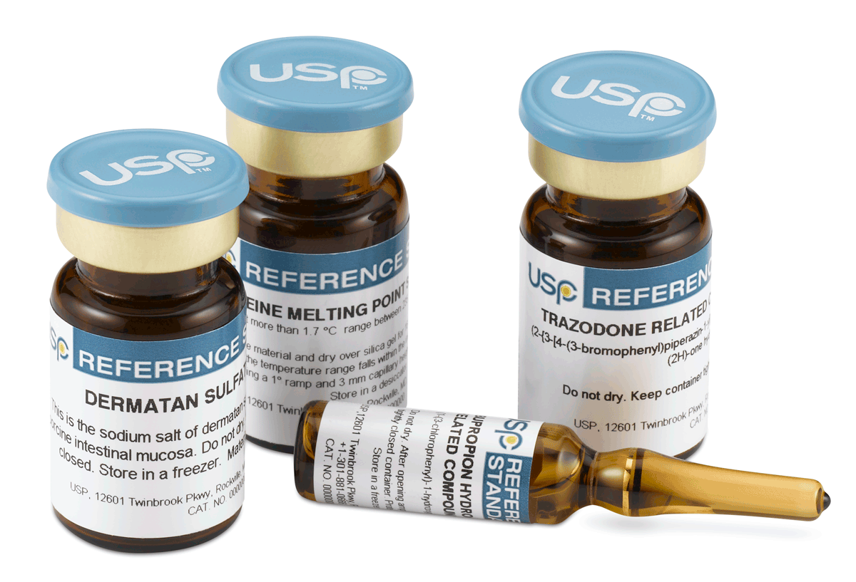
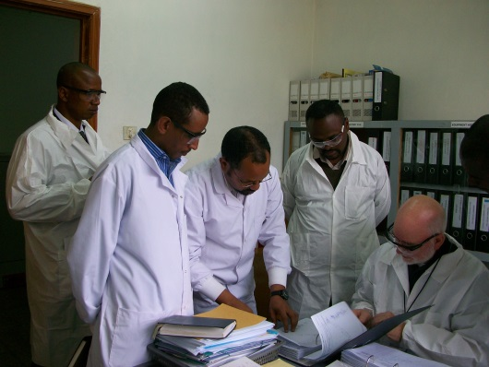
Technical Assistance to Manufacturers
Provide hands-on training and consultation to manufacturers on process/product development and manufacturing
  Provide guidance on API process development and scale-up
  Provide guidance on drug product development and scale-up
  Troubleshoot API and formulation process issues
  Support to product dossier
  Assist in the compilation of dossiers according to CTD format
  → CTD Module 3 (Quality) and Module 5 (BE/Clinical)
  Direct critical research to fulfill dossier requirements
  Support to facility GMP/GCP Compliance
  Manufacturers – GMP compliance
  Contract research organization – GCP/GLP compliance
Continuous follow-up and support until product approval

Slide 13
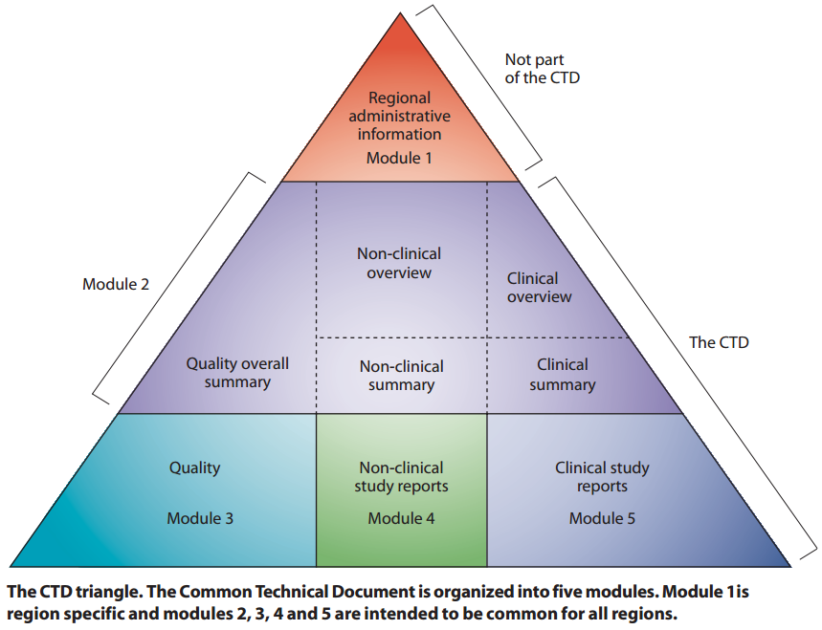
Dossier: Common Technical Document Format
Multisource (generic) products
CMC/cGMPs
BA/BE

Slide 14
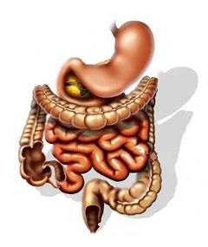
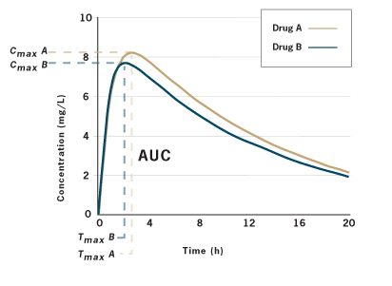
Major challenge: BA/BE Studies
High cost of BE studies and surge in notice of concern make this a key area of need
PQM provides technical support to regulators and CROs to conduct BA/BE studies, according to GCPs and GLPs
Training of regulators and CROs
  BA/BE guidance and procedures
  GCP Support - Protocol development, study conduct, monitoring, termination, QMS audit, PK/Stats analysis, reporting and documentation
  GLPs (ISO/IEC 15189,17034)
Reference (R)
Test (T)

Slide 15
GMP Technical Assistance Workflow
Manufacturers identified through EOI, PQM training workshops, or referral by external partners
PQM conducts screening of manufacturers using questionnaire and GMP walk-through
PQM conducts gap analysis (Dossier and Facility GMPs)
PQM verifies dossier prior to final submission and conduct pre-inspection mock audit (Support Continues Until Product Approval)
PQM assists manufactures to compile product dossier according to CTD format
PQM issues gap analysis report, work with manufacturers to develop CAPA plan, and complete CAPAs
PQM assists pharmaceutical manufacturers and regulator in low- and middle-income countries in achieving compliance with regulatory requirements of stringent markets, such the United States, Europe, and WHO Prequalification program.
Medicines regulatory authorities and manufacturers are trained in all aspect of dossier and cGMPs.
By obtaining the approval of a stringent regulatory authority, quality-assured priority medicines become available to the public health market.

Slide 16
PQM Technical Assistance Results ─ WHO PQ, USFDA, EU
1 | Cycloserine FPP | Dong-A Pharma | WHO PQ | 2012
2 | Zinc Sulfate FPP | Lab Pharma Rodael | WHO PQ | 2012
3 | Streptomycin API | Shengxue Pharma | Spanish RA | 2013
4 | Isoniazid API | Second Pharma | WHO PQ | 2013
5 | Capreomycin API | NCPC Pharma | WHO PQ | 2014
6 | Capreomycin API | Hisun Pharma | WHO PQ | 2014
7 | Levofloxacin API | Langhua Pharma | WHO PQ | 2014
8 | Mebendazole API | Yabang Phama | CEP | 2014
9 | Azithromycin FPP | HEC Pharma | WHO PQ | 2014
10 | Capreomycin FPP | Hisun Pharma | WHO PQ | 2015
11 | Moxifloxacin API | Hisun Pharma | WHO PQ | 2015
12 | Zinc Sulfate FPP | Chi Pharma | UNICEF | 2015
13 | Kanamycin FPP | Interpharma/SHP | Global Fund ERP | 2015
14 | Kanamycin API ( non-sterile) | Fuzhou Fuxin Pharma | USFDA | 2015
15 | Kanamycin API ( non-sterile) | Fuzhou Fuxin Pharma | WHO PQ | 2015
16 | Kanamycin API (Sterile) | Fuzhou Fuxin Pharma | WHO PQ | 2016
17 | Mebendazole API | Changzhou Yabang Pharma | WHO PQ | 2016
18 | Cycloserine API | Dong-A Pharma | WHO PQ | 2016
19 | Streptomycin API | NCPC Huasheng Pharma | WHO PQ | 2016
20 | Rifampicin API | Shenyang Antibiotic Manufacturer | WHO PQ | 2016

Slide 17
PQM Portfolio ─ Current USAID Priority Medicines by Disease Program
Tuberculosis | Maternal, Newborn, Child Health | Neglected Tropical Disease
High Priority: Kanamycin Sulfate API, Clofazimine API, Clofazimine 100mg capsules Linezolid API, Linezolid 600 mg coated (scored) Gatifloxacin API, Gatifloxacin 200mg Tablet Gatifloxacin 400mg Tablet Moxifloxacin API Rifapentine FDC (Rifapentine with INH) Pediatric first line fixed-dosed combination (preferably dispersible or crushable tablets): Rifampicin(R) 75 mg/ Isoniazid 50mg / Pyrazinamide 150mg Rifampicin(R) 75 mg/ Isoniazid 50mg Medium Priority Capreomycin API Terizidone API Terizidone, tablet/capsule 250 mg Terizidone, tablet/capsule 300 mg Rifampicin API | High Priority: Amoxicillin 250 mg scored DT 7.1% Chlorhexidine digluconate (4%) gel 7.1% Chlorhexidine digluconate (4%) sol Medium Priority: Magnesium sulfate injection 500 mg/ml, in 2-ml and 10 ml ampoule Gentamicin injection 10mg/ml and 40 mg/ml, in 2-ml vial Medium - low Priority: Oxytocin, injection 10 IU, 1-ml Low Priority: Misoprostol 200-ug tablet Betamethasone injection 5.7 mg/ml (betamethasone sodium phosphate 3.9 mg/ml solution, or betamethasone acetate 3 mg aqueous suspension) Dexamethasone injection 4 mg injection (4 mg dexamethasone disodium phosphate in 1-ml ampoule) | High Priority: Praziquantel API Praziquantel 600mg Tablet Medium Priority: Mebendazole API Mebendazole 500mg tabet (chewable*) Albendazole API Albendazole 400mg tablet (chewable*, preferably scored)

Slide 18
Conclusion
PQM is a major contributor to capacity building technical assistance for regulators and manufacturers
PQM assists manufacturers shorten their timeline for WHO PQ, through hands-on assistance on product development, dossier preparation, cGMP and GCPs
With PQM technical assistance, manufacturers often pass the WHO PQ inspection on the first attempt
Through PQM capacity building activities, PQM ensures availability to quality-assured medicines

